Slide 1
Custom Working Group Hybrid Measure Break-Out
Ayad AL-SHAIKH
Stefano Galiasso
June 11, 2021

Slide 2
Overview
Review custom processes in other jurisdictions to help inform Hybrid Measure development
Background on Hybrid Measures development through Cal TF
PA perspective
Customer perspective
Key Hybrid elements
(optional) Process Boiler Example = Helps illustrate the value
Agree on Next Steps/Scope if we were to start a break-out group for this topic
Hybrid Measure structure
Hybrid Measure value
Best Hybrid Measure target candidates

Slide 3
Custom Practices
Looked into custom program of 5 jurisdictions to get best practices
Massachusetts (MassSave)
New York (ConEd)
Vermont (Efficiency Vermont)
Wisconsin (FocusOnEnergy)
Illinois (ComEd)
Custom is very standard (similar process)
Big differences:
Demonstrating program influence (usually easier)
Prospective vs Retrospective application of NTG
Smaller differences:
Engineering calculation workbooks provided for some common measures
Examples with accompanying data collection requirements
Simple application processes with short guidelines for implementers (< 4 pages)
ASK: contacts in other jurisdictions that implement custom programs and are familiar with NTG

Slide 4
PA point of view
Usually custom is a catch-all for “anything not prescriptive”
Wants to get as much information as possible to:
Assess baseline
Assess efficient upgrade
Assess attribution / influence (EM&V data)
Calculate savings:
Use regression model to estimate pre- and post- consumption differential
Use an energy model to simulate pre- and post- consumption (and measure difference capturing interactive effects, weather normalization, etc)
Use engineering assumptions to calculate savings
Trade-off:
More structure with a lot information means less participation (barrier to fill everything);
Less structure means higher participation (easier process) but higher uncertainty

Slide 5
Customer point of view
Doesn’t care about programs per se, just wants a quality installation, the reassurance from a third-party review, and to get the incentive/rebate
Goals: | Best Practices:
Shorten application time process | All follow a similar process
Reduce # of gates | IL, MA seems to have fewer steps than others (no required pre- and post-inspections, max 2 paperwork submission - before and after)
Simplify application process | NY has multiple offerings, 1-4 pages MAX to apply; Efficiency VT also multiple offerings (vertical-specific)
Added services | MA, NY, IL offer assessments / technical assistance (can be used to show influence?)

Slide 6
Proposed Key Elements of Hybrid
Looks like a deemed measure to the customer
Known rebate based upon typical “normalizing unit” (ie, HP, kBTUH, etc)
No pre-approval required to install the measure
Clear/streamlined requirement to document influence versus uses a deemed Net-to-Gross value
Clarity on documentation that is required (up-front)
Clear site-specific data collection requirements
Provides deeper / more complete documentation than a deemed measure
Notes:
Prospective NTG
Question: Do you think that these are the right barriers to remove:
Confidence/assurance in rebate
No pre-approval…move forward quickly
No influence documentation
Clarity on what is required for submittal (NOTE – it is not expected to be minimal documentation, but instead it should be one full package)
What else? What is not needed?

Slide 7
Hybrid Measure – Value
Improve customer participation in programs / customer perception
Reduces time and transaction costs for implementers
Captures data in a structured format that could:
Improve inputs over time
Result in converting the hybrid measure to a deemed measure
Balances:
Maximizing rate-payer funds by streamlining the process
Providing more site-level data than a typical deemed measure

Slide 8
Hybrid Measure – Target Measure
Target Measure
Installed frequently, repeatably throughout the state
Enough clarity about the installation exists that there is acceptable trade-off between rigor and:
Reduce uncertainty of the measure savings amount,
Persistence,
Double-dipping,
Gaming,
Etc.
Notes:
Question: Would this improve customer perception of the “custom” and increase participation?
Question: How can we avoid pitfalls or perception of pitfalls?

Slide 9
Many Flavors of Hybrid
Process Boilers – Distinct line already between deemed/custom
Pipe Insulation, Nonresidential – Only deemed now, but could expand
Chillers, Non-Process – Fill holes in offerings, but could expand
Lighting – MLC/Custom Lite - Only custom now
Specialty markets – repeatable custom measures (tbd)
Deemed
Custom
Deemed
Existing
Conditions
Deemed
Custom
Custom

Slide 10
Hybrid Process Boiler Measure
Chau Nguyen
Ayad Al-Shaikh

Slide 11
Process Boiler - Histogram
Deemed Measure: SWWH008 Process Boiler
Normal replacement of ≤ 20 MMBtu/hr process boiler
Deemed: ¾ of the applications are 1/3 of the savings​
Hybrid: ¼ of the applications are 2/3 of the savings
NR, ≤ 20 MMBtu/hr
> 20 MMBtu/hr
Deemed
Custom
Deemed
Hybrid
Custom
NR, ≤ 10 MMBtu/hr
NR, 10 < x < 20
> 20 MMBtu/hr
Notes:
Data comes from IOU Q1-2017 to Q3-2018

Slide 12
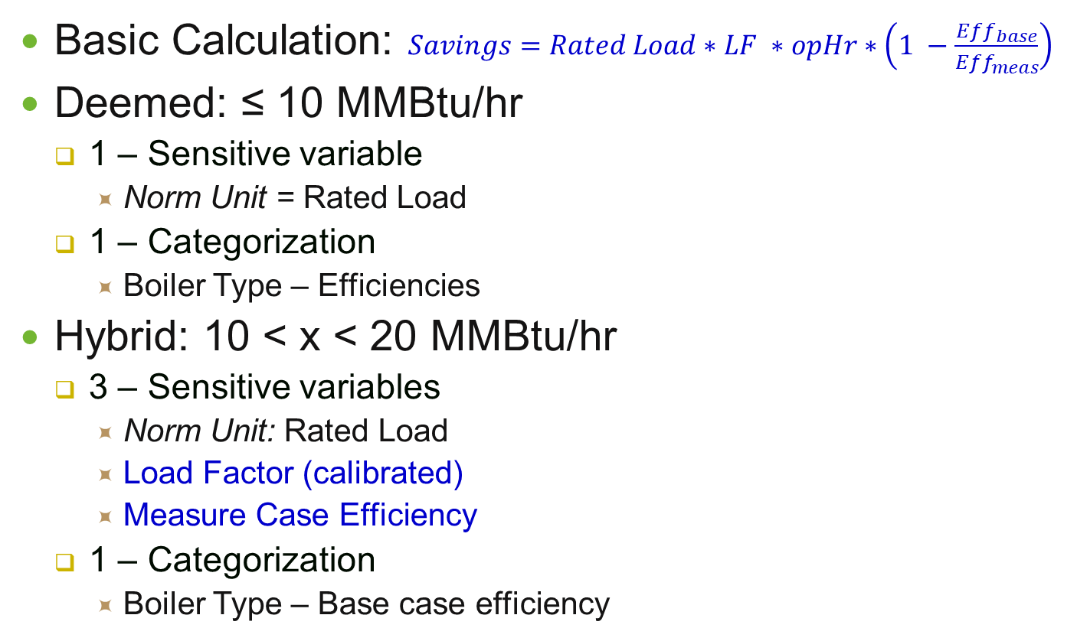
Process Boiler – Savings Calculation
Basic Calculation: $Savings=Rated Load∗LF ∗opHr∗\left(1 −\frac{Eff_{base}}{Eff_{meas}}\right)$
Deemed: ≤ 10 MMBtu/hr
1 – Sensitive variable
Norm Unit = Rated Load
1 – Categorization
Boiler Type – Efficiencies
Hybrid: 10 < x < 20 MMBtu/hr
3 – Sensitive variables
Norm Unit: Rated Load
Load Factor (calibrated)
Measure Case Efficiency
1 – Categorization
Boiler Type – Base case efficiency
 | HW I | HW II | Steam
Eff_{base} | .82 | .82 | .80
Eff_{meas} | .85 | .90 | .83
 | HW I | Steam
Eff_{base} | .82 | .80
Notes:
Definition:
Sensitive Variable – variable that scales the savings that will be claimed based upon input value
Categorization – variable that categorizes the savings to choose an average value

Slide 13
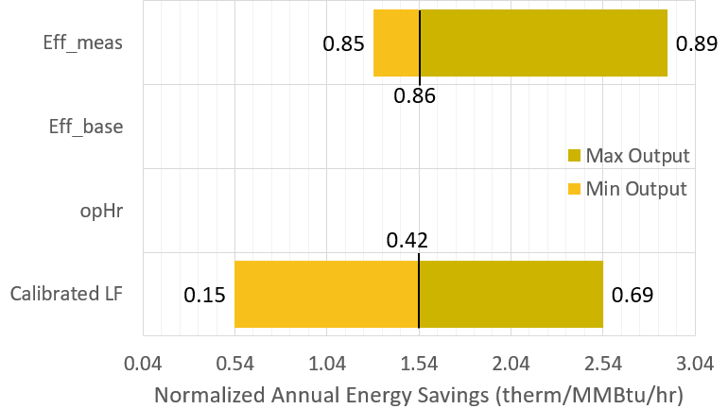
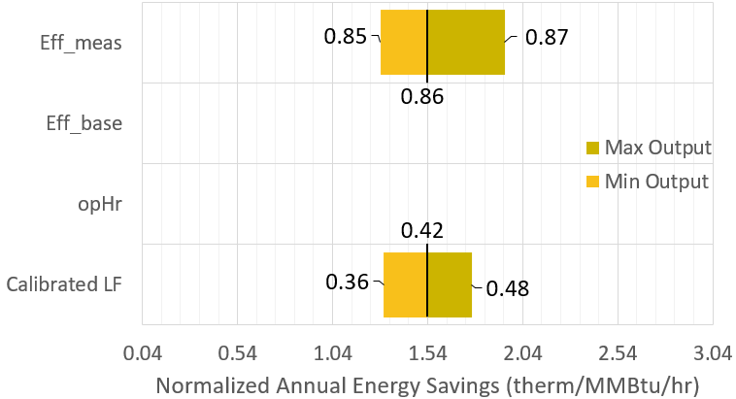
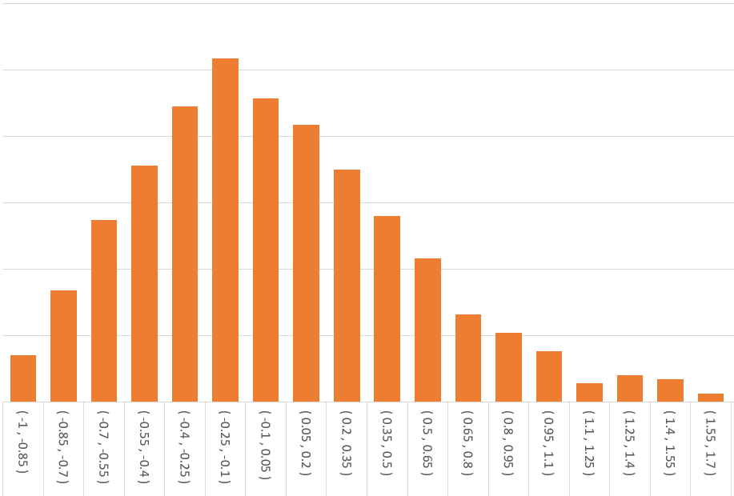
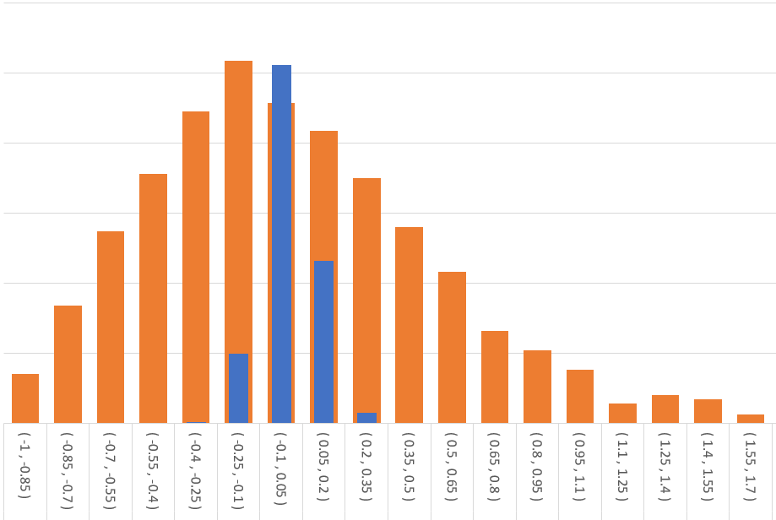
Process Boiler – Hot Water
Deemed
Hybrid
Notes:
Eff_meas comes from SWWH008 definition
* See previous slide tables
* Itron 2014 and 2015 Pipe Insulation Impact Data
Eff_base is set by Title 20
Calibrated LF from SWWH008 (R449 - Oak Ridge National Laboratory Characterization of US Boiler Study)
OpHr = 8760 hrs : SWWH008 calculation methodology
*LF means what’s the average load of the boiler year-round. So variation of opHr is accounted for in LF

Slide 14
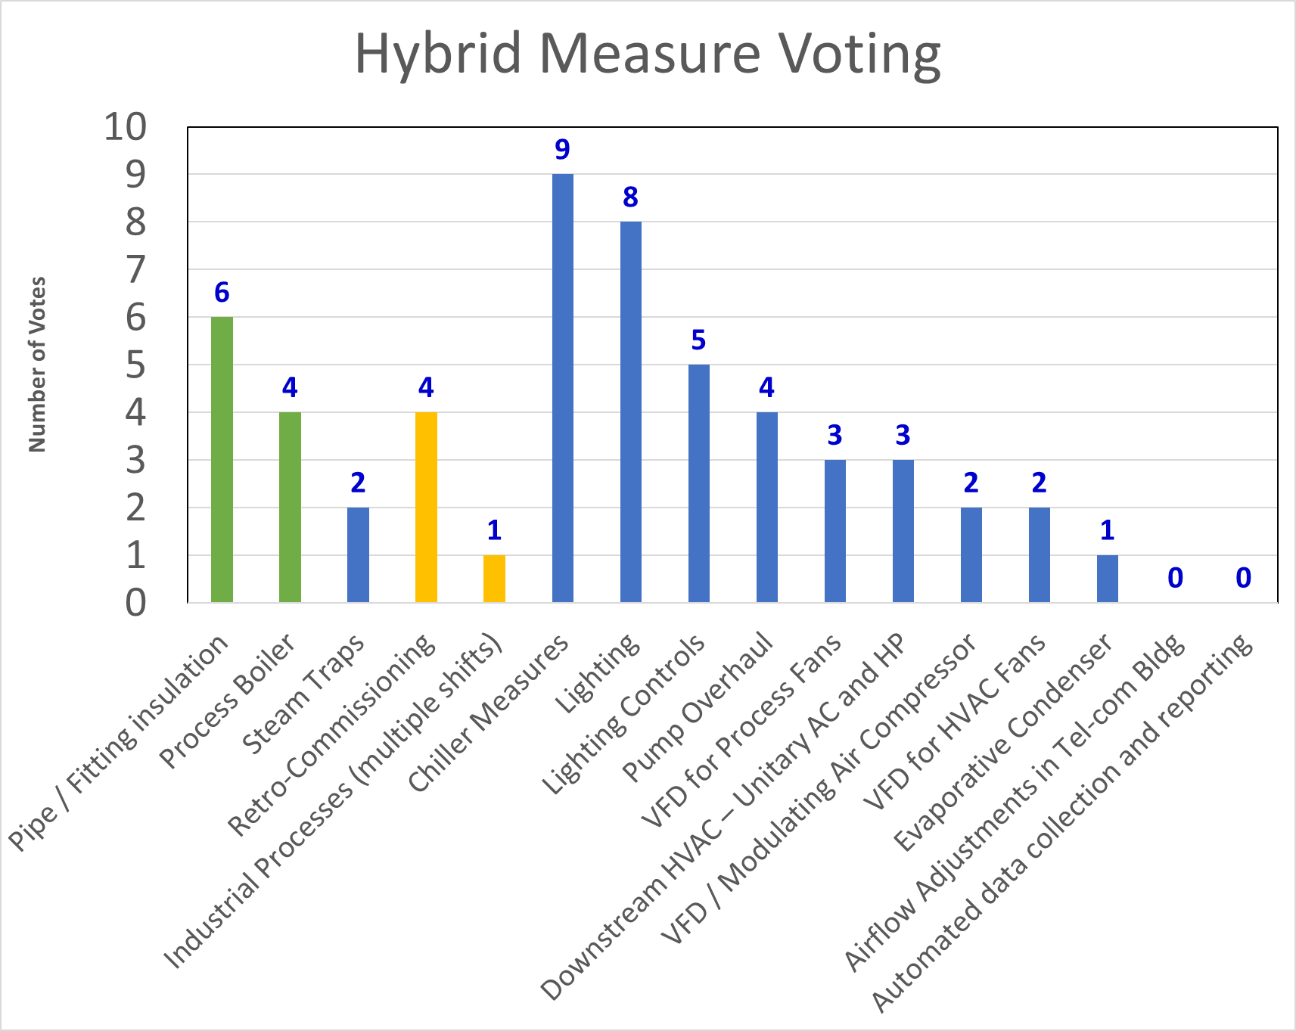
Early Hybrid Examples
Notes:
Question: What measures should we attempt first? We want to show the value of the process?
Question: Are there enough measures installed separately (ie, not bundles)?

Slide 15
Thoughts for Next Steps
Discuss the Key Elements of a Hybrid measure
Re-evaluate the first examples of statewide Hybrid measures
Evaluate any policy concerns with Hybrid measures

