Slide 1
Deemed Measure Property Data
Randy Kwok
Ayad Al-Shaikh
September 2023
We would like to record this meeting so that it can be shared with stakeholder who could not attend. We will ask for concerns at the start.

Slide 2
Deemed Measure Property Data
Goals for Today:
Describe findings from the first small batch of HVAC MPD Validation Lists
Guidance on how to review MDPs efficiently
Stakeholder consensus on approach
Share the schedule going forward
Don’t Forget
Conventions and Library items
Access to files is through SharePoint
We will be transition to different site soon.
But make sure you have access now
Original Memo (for context) on Cal TF website
Memo from Jan 2023

Slide 3
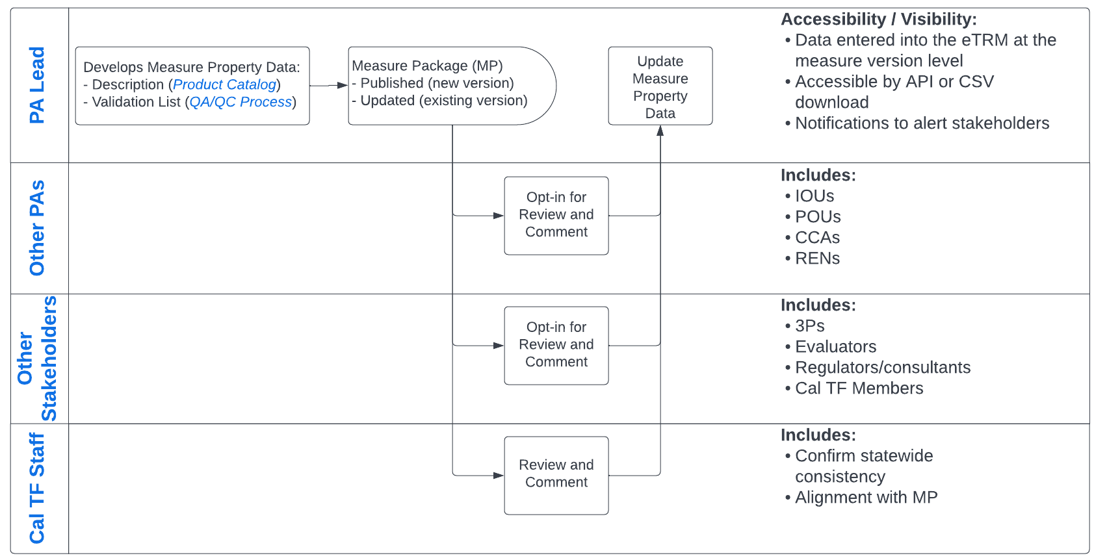
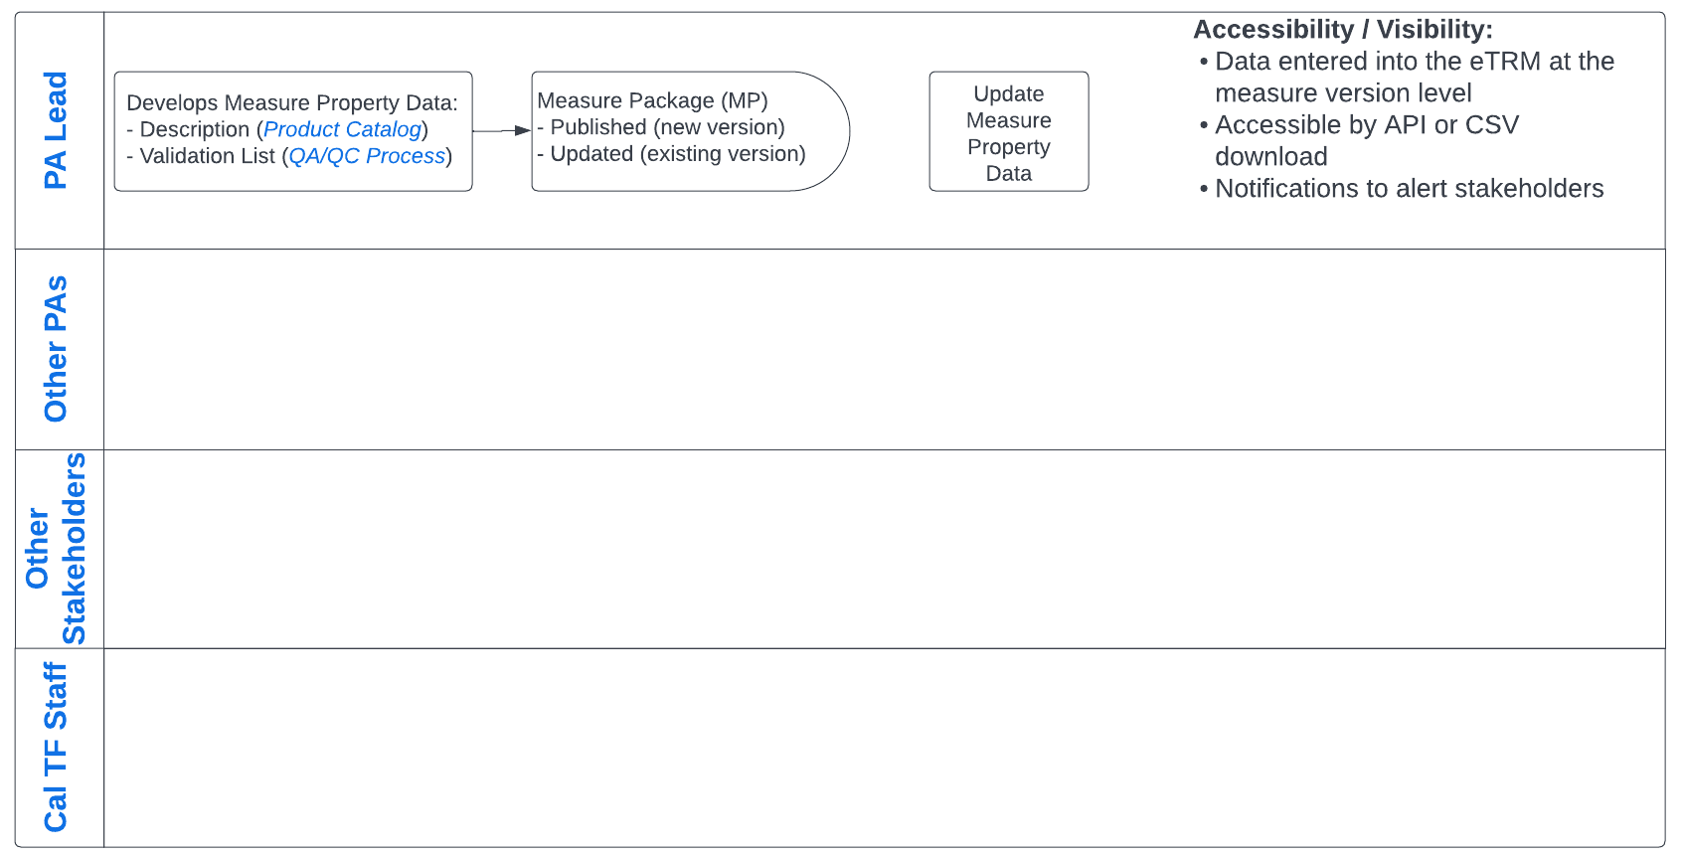
Next Steps: Statewide Process

Slide 4
Proposed Schedule
Use Categories | Total Num | MPD Draft Due | Hand-off to External Stakeholders | Meeting with External Stakeholders | Final Comments from External Stakeholders
First Batch of HVAC | 12 | varies | 9/8 | 9/14 | (part of 3rd group)
Appliance/Plug Load, Bldg Envelope, Compressed Air, Comm Refrigeration | 37 | 9/8 | 9/22* (may not all be available at the same time) | Week of 10/2 (usually Thur) | 11/3
Lighting, Service, Whole Bldg, Food Service, Misc | 40
Process, Recreation, HVAC | 47
Service and Domestic Hot Water, Water Pumping / Irrigation | 35

Slide 5
High Level Guidance – Focus of Review
Measure Property Fields
Property Label - Is it clear and concise?
Property Description - Is the data collection practice valid?
Measure Property Validation
Check Point 1 - Is the checkpoint reasonable?
Verification 1 - Is the data verification approach valid and explicit?
Pass Criteria 1 - Are the pass criteria clear?
Check Point 2 / Verification 2 / Pass Criteria 2 - Is the alternate validation reasonable and valid?
Notes:
Valid – will it satisfy all requirement (quality installation, verification, valid, ...)
Think through doable verification

Slide 6
MPD Validation List Examples
SWHC045 - Heat Pump HVAC, Residential, Fuel Substitution
SWHC023 - Enhanced Ventilation for Packaged HVAC
SWHC009 - Supply Fan Controls, Commercial

Slide 7
Next Steps
Feedback:
Which groups are you particularly interested in reviewing?
Any initial feedback on HVAC batch of 12?
Reach out to Randy by: Fri, 9/22
First Big Batch (of Four Batches)
Hand-off: Available to preview on 9/22
Meeting: Share findings on Thur, 10/5 (about 2 weeks later)
Comments: Opt-In Feedback by 11/3 (about 4 weeks later)
Upload into the eTRM in Q1 2024
Note: When we move to the new SharePoint site, you will see meeting dates summarized, so you can keep track.

Slide 8
Back-up Slides

Slide 9
Issue and Opportunity – Existing Process
Verification / Eligibility Requirements
Deemed Measure Claims
Implementer/Customer
Program Administrator
CPUC/CEC
Claim Package
QA/QC Process
Submitted Claims
Product Catalog
Rejected or Request for Additional Information

Slide 10
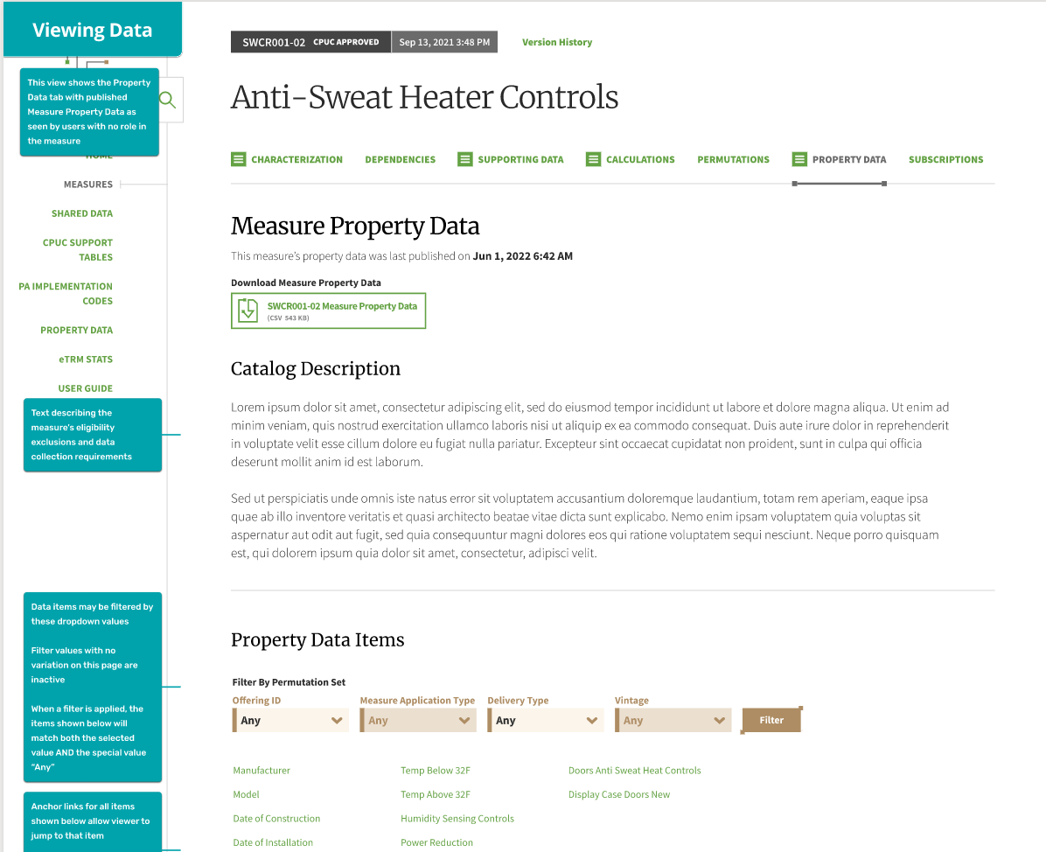
eTRM Wireframe
Separate tab for this data
Downloadable within the version
Hyperlinks to individual Validation Items
Filter for a specific permutation’s requirements
Download all validations lists
Should be integrated into the eTRM by the end of February.

Slide 11
Draft Statewide Process

Slide 12
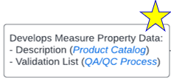
Development of Validation Lists
Validation List Library
Latest version on Cal TF Subcommittee site (reviewed)
Always being added to...This is your time to add feedback before the items are incorporated into many lists.
Validation List Tool
Supports entry and will allow import into the eTRM
Drafting of Lists has started

