Slide 1
Miscellaneous Measures
Cal TF Tier 2 Presentation
Ayad Al-Shaikh
March 2019

Slide 2
Measure Affirmation List

Slide 3
Measure Affirmation
“Cal TF affirms the subcommittee recommendations regarding ‘Stage 1 Issues’ for various Measures.”
2.20, Conveyor Broiler, Commercial
2.21, Refrigerated Chef Bases
7.13, Under Counter Type Dishwasher, Commercial
7.36, Gas Dryer Modulating Valve, Commercial
6.29, Flow Control Valve, Res & Non-Res
6.30, Dual Set Point Boiler Control for MF Space Heating
5.06, Demand Controlled Ventilation for Single Zone Packaged HVAC
5.49, Enhanced Ventilation for Packaged HVAC with Gas Heating or Packaged Heat Pump
5.56, Single Package Vertical Heat Pump, K-12 and Community Colleges
5.30, Refrigerant Charge, Commercial
5.31, Evaporator Coil Cleaning, Commercial
5.32, Condenser Coil Cleaning, Commercial
5.10f, Brushless Fan Motor Replacement, Residential
5.13, Fan Delay Controller for Air Conditioner, Residential
9.01, Pool Cover, Commercial

Slide 4
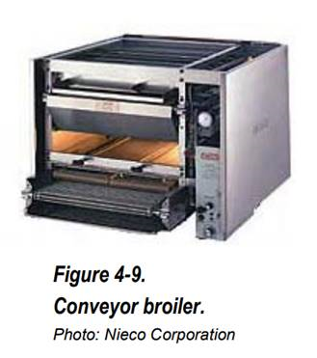
Measure Consensus –
2.20 - Conveyor Broiler, Commercial
  Offering
  Implementation: NR, NC
  Building Types: Any
  Climate zones: Any
  Norm Unit: Each
  Stage 1 Issues
  Normalize to 365 days/yr to be consistent with other Food Service measures
    This should also be consistent with the approach agreed upon through the current Food Service studies
  Calculation methodology clarified.
  Small number of claims by Q3 2018.
  Measure Extension
  Add POUs and SDG&E
Stage 2 Issues
  Smaller quick service restaurants that utilize conveyor broilers have not yet been characterized.
Black text = Current state of the consolidated measure
Blue text = Changing and / or first time item is mentioned
Italics text = Item that has not been completed
Notes:
Automated conveyor broilers cook food by direct and indirect contact with gas-fired flames, giving the product a signature flame-broiled flavor and texture. These types of broilers are mostly used for cooking burgers, but can also cook a variety of other foods including grilled chicken and vegetables. Food is placed on a conveyor belt which runs through a cooking cavity. Gas burners reside above and below the belt carrying the food product. There are two types of automatic conveyor broiler configurations: larger “through” broilers where food product is fed into one side of the unit and exits on the opposite end, and “return” broilers where food product is discharged on the same side as the feed. Typical ¼-lb frozen burger patty cook times range between two and three minutes. Some units have two conveyors with independently adjustable speeds. Another type of automated broiler cooks food in batches instead of continuously; the food is then placed inside a holding cabinet prior to serving.
Typical conveyor broilers operate at a constant input rate maintaining average cavity temperatures between 600 and 700°F. The temperature is regulated by a gas manifold pressure adjustment. Constant input rate broilers do not differentiate between cooking and idle operation – the broiler operates at the same rate throughout the day. Technology advancements in broiler technology are mostly centered around controls that either adjust the input rate of the broiler based on cooking conditions or turn the gas heating elements on/off to maintain temperature. Advanced automatic conveyor broilers utilize a dual-stage gas valve which reduces the input rate during cooking conditions to prevent flare ups. Advanced automatic batch broilers cycle gas burners on/off to maintain cooking cavity temperature. Broilers utilizing a catalyst on top of their cooking cavity reduce emissions and further insulate the cavity, resulting in lower input rates needed to maintain cooking temperatures. Advanced automatic conveyor broilers also use active airflow management techniques to recirculate hot air inside the cavity, resulting in lower gas input rates needed to maintain cooking temperatures.

Slide 5
Measure Consensus –
2.20 - Conveyor Broiler, Commercial
  Savings
  Base Case
    Constant input rate between 600°F to 700°F.
    Broilers do not differentiate between cooking and idle operation – the broiler operates at the same rate throughout the day.
  Measure Case
    Efficient units better control the input rate.
    Advanced automatic conveyor broilers utilize a dual-stage gas valve which reduces the input rate during cooking conditions to prevent flare ups.
    Advanced automatic batch broilers cycle gas burners on/off to maintain cooking cavity temperature.
    Further insulating the cavity and actively recirculating hot air inside the cavity result in lower input rates.
Black text = Current state of the consolidated measure
Blue text = Changing and / or first time item is mentioned
Italics text = Item that has not been completed
Notes:
Automated conveyor broilers cook food by direct and indirect contact with gas-fired flames, giving the product a signature flame-broiled flavor and texture. These types of broilers are mostly used for cooking burgers, but can also cook a variety of other foods including grilled chicken and vegetables. Food is placed on a conveyor belt which runs through a cooking cavity. Gas burners reside above and below the belt carrying the food product. There are two types of automatic conveyor broiler configurations: larger “through” broilers where food product is fed into one side of the unit and exits on the opposite end, and “return” broilers where food product is discharged on the same side as the feed. Typical ¼-lb frozen burger patty cook times range between two and three minutes. Some units have two conveyors with independently adjustable speeds. Another type of automated broiler cooks food in batches instead of continuously; the food is then placed inside a holding cabinet prior to serving.
Typical conveyor broilers operate at a constant input rate maintaining average cavity temperatures between 600 and 700°F. The temperature is regulated by a gas manifold pressure adjustment. Constant input rate broilers do not differentiate between cooking and idle operation – the broiler operates at the same rate throughout the day. Technology advancements in broiler technology are mostly centered around controls that either adjust the input rate of the broiler based on cooking conditions or turn the gas heating elements on/off to maintain temperature. Advanced automatic conveyor broilers utilize a dual-stage gas valve which reduces the input rate during cooking conditions to prevent flare ups. Advanced automatic batch broilers cycle gas burners on/off to maintain cooking cavity temperature. Broilers utilizing a catalyst on top of their cooking cavity reduce emissions and further insulate the cavity, resulting in lower input rates needed to maintain cooking temperatures. Advanced automatic conveyor broilers also use active airflow management techniques to recirculate hot air inside the cavity, resulting in lower gas input rates needed to maintain cooking temperatures.

Slide 6
Input Consensus –
2.20 - Conveyor Broiler, Commercial
Measure Permutations

Slide 7
Measure Consensus –
2.21 - Refrigerated Chef Bases
  Offering
  Implementation: NR, NC
  Building Types: Hsp, Htl, Mtl, Nrs, RFF, RSD
  Climate zones: Any
  Norm Unit: Each
  Stage 1 Issues
  DEER2020 Peak Shift consistent with other Food Service Measures
  No savings by Q3 2018.
  Measure Extension
  Add POUs, PG&E, and SDG&E
Stage 2 Issues
  Establish additional efficiency tiers once more manufacturers are creating efficient products.
Black text = Current state of the consolidated measure
Blue text = Changing and / or first time item is mentioned
Italics text = Item that has not been completed
Notes:
Refrigerated Chef Bases are found in almost all commercial kitchens. These appliances are designed to support heavy and/or hot cooking equipment on the top and refrigerated compartments underneath for quick and easy access to various refrigerated products. They range from approximately three feet to over eight feet in exterior length. The refrigerated compartment can be equipped with drawers or doors depending on a customer’s desired specifications. Typical chef bases operate using a conventional vapor compression refrigeration cycle charged with R-404a or R-290 propane.

Slide 8
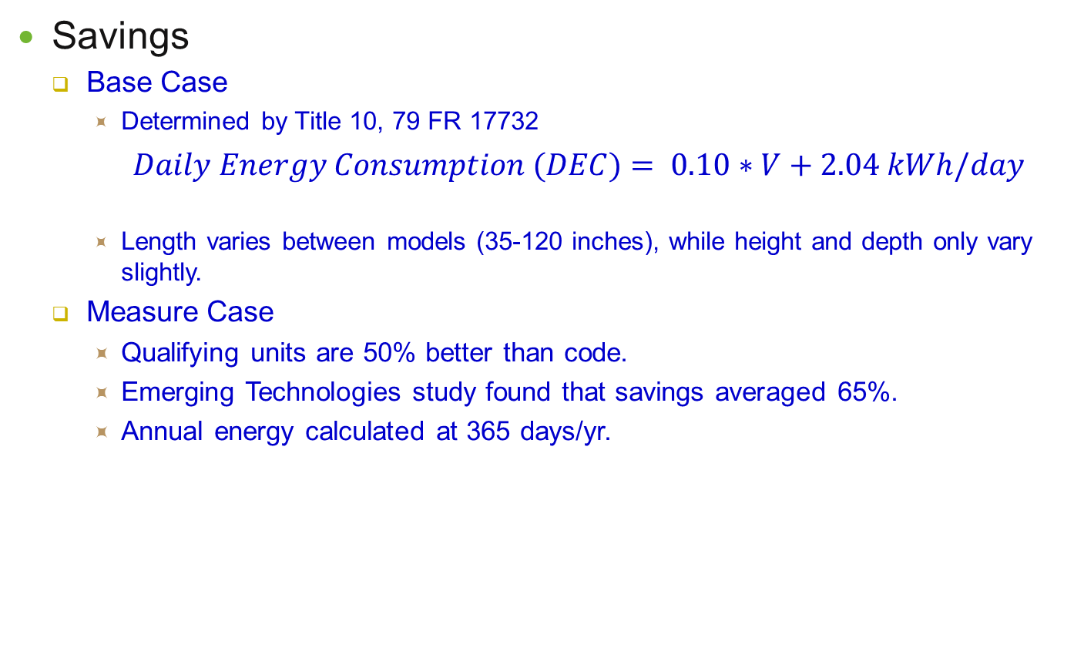
Measure Consensus –
2.21 - Refrigerated Chef Bases
  Savings
  Base Case
    Determined by Title 10, 79 FR 17732
    $Daily Energy Consumption (DEC)= 0.10∗V+2.04 kWh/day$
    Length varies between models (35-120 inches), while height and depth only vary slightly.
  Measure Case
    Qualifying units are 50% better than code.
    Emerging Technologies study found that savings averaged 65%.
    Annual energy calculated at 365 days/yr.
Black text = Current state of the consolidated measure
Blue text = Changing and / or first time item is mentioned
Italics text = Item that has not been completed
Notes:
Refrigerated Chef Bases are found in almost all commercial kitchens. These appliances are designed to support heavy and/or hot cooking equipment on the top and refrigerated compartments underneath for quick and easy access to various refrigerated products. They range from approximately three feet to over eight feet in exterior length. The refrigerated compartment can be equipped with drawers or doors depending on a customer’s desired specifications. Typical chef bases operate using a conventional vapor compression refrigeration cycle charged with R-404a or R-290 propane.

Slide 9
Input Consensus –
2.21 - Refrigerated Chef Bases
Measure Permutations

Slide 10
Measure Consensus –
7.13 - Under Counter Type Dishwasher, Commercial
  Offering
  Implementation: NR, NC
  Building Types: Any
  Climate zones: Any
  Norm Unit: Each
  Stage 1 Issues
  DEER2020 Peak Shift consistent with other Food Service Measures
  Savings are not climate zone dependent (consistent with Door-type Dishwasher)
  Confirm update of NTGR-ID: All-Default<=2yrs
  No savings by Q3 2018.
  Measure Extension
  Add POUs, PG&E, and SDG&E
Stage 2 Issues
  Further field studies are recommended to improve the quality of water consumption data.
Black text = Current state of the consolidated measure
Blue text = Changing and / or first time item is mentioned
Italics text = Item that has not been completed
Notes:
This work paper documents the inputs for the Energy Efficient undercounter Commercial Dishwashers measure. Of the many types of commercial dishwashers available, including door-type and conveyor-types, undercounter units accounted for 43% of the market share by sales volume (NAFEM Size and Shape of the Industry 2009-2011 data). Undercounter dishwashers are mostly found in bars and restaurants with bars and are mainly used for washing glassware.
This work paper addresses both low temperature and high temperature undercounter dishwasher units. Low temperature units meet the National Sanitation Foundation mandated sanitation criteria via a final rinse chemical sanitizing solution that follows the wash cycle. (NSF/ANSI 3-2017 standard) High temperature units achieve sanitation via a high temperature booster of 180°F water for the final rinse. These differences in sanitizing methods affect the division of energy consumption of low versus high temperature units. For low temperature machines, most of energy used is associated with primary water heating, with the remaining energy attributed to tank heaters and pumps. For high-temperature machines, less of the total energy consumption is for primary water heating with a significant portion for booster water heating, and the remaining is attributed to the motor, wash tank heater, controls, and standby energy. It is assumed that the motors and controls components do not vary significantly between standard and high-efficiency dishwasher units. However, water consumption, and therefore water heating requirements, does vary significantly between standard and high-efficiency units and constitutes the measure energy savings.
High efficiency commercial dishwashers reduce water heating requirements while maintaining cleaning performance by reducing heat losses, improving mechanical soil removal, and/or increasing component efficiencies. By using strategies such as waste air heat recovery, drain heat recovery, rinse water re-use, double-walled insulated construction, high efficiency anti-clogging nozzles, continuous filtering, and efficient boost heaters, water consumption can be reduced from as high as 2.0 gallons/rack to less than 0.5 gallons/rack, depending on the type of dishwasher

Slide 11
Measure Consensus –
7.13 - Under Counter Type Dishwasher, Comm
  Savings
  Base Case
    The Measure addresses both low temperature and high temperature undercounter dishwasher units.
    For low temperature machines, most of energy used is associated with primary water heating, with the remaining energy attributed to tank heaters and pumps.
    For high-temperature machines, less of the total energy consumption is for primary water heating with a significant portion for booster water heating, and the remaining is attributed to the motor, wash tank heater, controls, and standby energy.
      Base = 1.0 gal/rack (high temp); 1.7 gal/rack (low temp)
  Measure Case
    Water consumption, and therefore water heating requirements, does vary significantly between standard and high-efficiency units and constitutes the measure energy savings.
    By using strategies such as waste air heat recovery, drain heat recovery, rinse water re-use, double-walled insulated construction, high efficiency anti-clogging nozzles, continuous filtering, and efficient boost heaters, water consumption can be reduced
    For gas savings, both units reduce water consumption:
      Tier 1 = 0.86 gal/rack (high temp); 1.19 gal/rack (low temp)
      Tier 2 = 0.73 gal/rack (high temp); 1.01 gal/rack (low temp)
    High temp machines also reduce Idle Energy Rate for electric savings.
Black text = Current state of the consolidated measure
Blue text = Changing and / or first time item is mentioned
Italics text = Item that has not been completed
Notes:
This work paper documents the inputs for the Energy Efficient undercounter Commercial Dishwashers measure. Of the many types of commercial dishwashers available, including door-type and conveyor-types, undercounter units accounted for 43% of the market share by sales volume (NAFEM Size and Shape of the Industry 2009-2011 data). Undercounter dishwashers are mostly found in bars and restaurants with bars and are mainly used for washing glassware.
This work paper addresses both low temperature and high temperature undercounter dishwasher units. Low temperature units meet the National Sanitation Foundation mandated sanitation criteria via a final rinse chemical sanitizing solution that follows the wash cycle. (NSF/ANSI 3-2017 standard) High temperature units achieve sanitation via a high temperature booster of 180°F water for the final rinse. These differences in sanitizing methods affect the division of energy consumption of low versus high temperature units. For low temperature machines, most of energy used is associated with primary water heating, with the remaining energy attributed to tank heaters and pumps. For high-temperature machines, less of the total energy consumption is for primary water heating with a significant portion for booster water heating, and the remaining is attributed to the motor, wash tank heater, controls, and standby energy. It is assumed that the motors and controls components do not vary significantly between standard and high-efficiency dishwasher units. However, water consumption, and therefore water heating requirements, does vary significantly between standard and high-efficiency units and constitutes the measure energy savings.
High efficiency commercial dishwashers reduce water heating requirements while maintaining cleaning performance by reducing heat losses, improving mechanical soil removal, and/or increasing component efficiencies. By using strategies such as waste air heat recovery, drain heat recovery, rinse water re-use, double-walled insulated construction, high efficiency anti-clogging nozzles, continuous filtering, and efficient boost heaters, water consumption can be reduced from as high as 2.0 gallons/rack to less than 0.5 gallons/rack, depending on the type of dishwasher

Slide 12
Input Consensus –
7.13 - Under Counter Type Dishwasher, Commercial
Measure Permutations

Slide 13
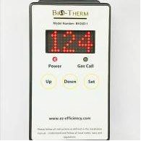
Measure Consensus –
7.36 - Gas Dryer Modulating Valve, Commercial
  Offering
  Implementation: AOE
  Building Types: COL (coin operated),
    Com, Htl, MFm, Mtl, Nrs
  Climate zones: Any
  Norm Unit: Each
  Stage 1 Issues
  Confirm that EUL is appropriate; equipment may not be integral to the Dryer
  Confirm that EUL sector is appropriate (for MFm = Res)
  SCG savings Q1-Q3 2018: 108,000 therms; PG&E savings (75,000 therms)
  Measure Extension
  Add PG&E, and SDG&E
Stage 2 Issues
  Studies in smaller size unit (20 lb range) will help evaluate the modulating valve in the multifamily sector
  Material cost data
Black text = Current state of the consolidated measure
Blue text = Changing and / or first time item is mentioned
Italics text = Item that has not been completed
Notes:
A modulating two stage unit replaces the single stage valve of an existing natural gas dryer with associated sensors in the flue exhaust. This device modulates the valve from low to high fire and is controlled by the feedback from the temperature sensor in the flue exhaust. This allows for a reduction of natural gas consumption per dryer load-cycle by the burner. It is considered that during the initial stages of a dryer cycle the moisture content is at maximum, therefore a high fire rate is needed to reduce the moisture. During the later stages of the cycle, the moisture content has been reduced and a higher fire rate creates more than necessary heat. This modulating valve allows for the lower fire rate to function when the moisture content has been reduced from maximum. Currently most standard dryers have a single fire rate and this modulating technology will make them consume less energy while performing the same function.

Slide 14
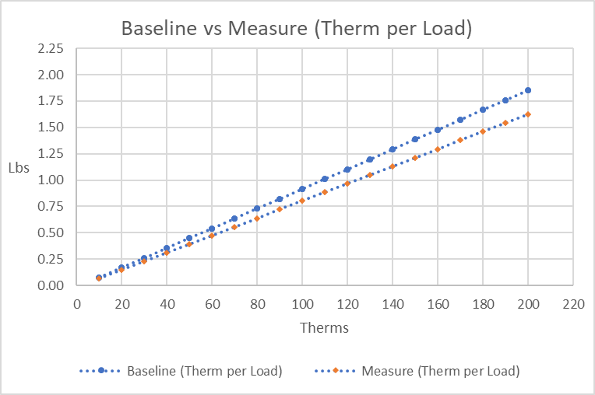
Measure Consensus –
7.36 - Gas Dryer Modulating Valve, Commercial
  Savings
  Base Case
    Coin Operated and MFm: Custom project data establishes burner on-time and regression curve (not shown)
    Com, Htl, Mtl, Nrs: PG&E, SCG and Nicor studies/projects used to establish “therms/lb/drying cycle” regression curve (above) – larger usage/more conservative
    Drying cycle/year calculated from Commercial Dryer-OPL Market Survey based upon building type
  Measure Case
    During the later stages of the cycle, the moisture content has been reduced and a higher fire rate creates more than necessary heat. A modulating valve allows for the lower fire rate to function when the moisture content has been reduced from maximum.
    Temperature sensor located in the flue exhaust.
    Nicor ET pilot documents 12.4% reduction in gas (5 sites / 11 dryers)
Black text = Current state of the consolidated measure
Blue text = Changing and / or first time item is mentioned
Italics text = Item that has not been completed
Notes:
A modulating two stage unit replaces the single stage valve of an existing natural gas dryer with associated sensors in the flue exhaust. This device modulates the valve from low to high fire and is controlled by the feedback from the temperature sensor in the flue exhaust. This allows for a reduction of natural gas consumption per dryer load-cycle by the burner. It is considered that during the initial stages of a dryer cycle the moisture content is at maximum, therefore a high fire rate is needed to reduce the moisture. During the later stages of the cycle, the moisture content has been reduced and a higher fire rate creates more than necessary heat. This modulating valve allows for the lower fire rate to function when the moisture content has been reduced from maximum. Currently most standard dryers have a single fire rate and this modulating technology will make them consume less energy while performing the same function.

Slide 15
Input Consensus –
7.36 - Gas Dryer Modulating Valve, Commercial
Measure Permutations

Slide 16
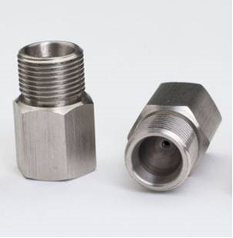
Measure Consensus
6.29 - Flow Control Valve
  Offering
  Implementation: AOE
  Building Types: Any (Res and Non-Res)
  Climate zones: CZ01-CZ16
  Norm Unit: Each
  Stage 1 Issues
  Measure case flow reduction accomplished by reducing the water flow while maintaining pressure through its converging-diverging structure in which the area is reduced at the throat to lower the flow rate.
  Savings match existing values from aerator / showerhead measures
    Determine the structure in the eTRM (new offerings or new measures)
  No savings by Q3 2018.
  Measure Extension
  Add PG&E and SDG&E
Stage 2 Issues
  None.
Black text = Current state of the consolidated measure
Blue text = Changing and / or first time item is mentioned
Italics text = Item that has not been completed
Notes:
Flow Control Valves(FCVs) reduce the incoming flow rate to the units specified GPM. This is accomplished by reducing the water flow while maintaining pressure through its converging-diverging structure in which the area is reduced at the throat to lower the flow rate. In showerhead applications the FCV is installed between the showerhead arm and the showerhead. In faucets, two FCVs shall be used, one at the hot and cold line stop angles.

Slide 17
Input Consensus
6.29 - Flow Control Valve
Measure Permutations
  Same as flow restrictor workpapers
  SWWH001-01 EAD - Faucet Aerator, Residential
  SWWH002-01 EAD - Low-flow Showerhead, Residential
  SWWH019-01 EAD - Faucet Aerator, Commercial
  SWWH020-01 EAD - Low-flow Showerhead, Commercial

Slide 18
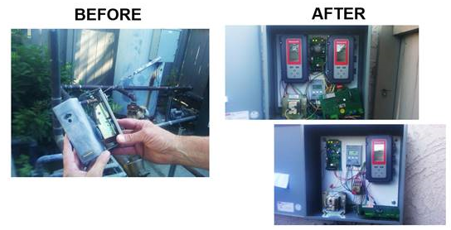
Measure Consensus
6.30 - Dual Set Point Boiler Control for Space Heating, Multifamily
  Offering
  Implementation: AOE
  Building Types: MFm
  Climate zones: CZ01-CZ16
  Norm Unit: Household
  Stage 1 Issues
  Measure parameters and structure matches other MFm water heating controls measures
    Other measures use an average climate value
    Other measures use a fixed total measure cost that scales based upon number of dwelling units
  Consider EUL update
  Energy Plus modelled result
  No savings by Q3 2018.
  Measure Extension
  Add PG&E and SDG&E
Stage 2 Issues
  None.
Black text = Current state of the consolidated measure
Blue text = Changing and / or first time item is mentioned
Italics text = Item that has not been completed
Notes:
The measure case utilizes an electronic controller that responds to hot water demand and weather conditions by controlling the supply water temperature setpoint reset based on outside air temperature. With that, it fires the fewest stages needed to meet the heating load.
The application of combi systems (combined space heating and domestic hot water) during warmer weather allow the temperature of hot water delivered to the dwelling units to be turned down from 135°–140°F to about 120°F. This reduction in temperature setpoint allows the system to operate at lower heating capacity and reduces pipe heat loss in the distribution system, thereby saving energy. Furthermore, the advanced controller monitors return water temperature to further reduce supply water setpoint during periods of warmer weather and/or low building heating demand. Another feature is burner staging optimization to prevent temperature setpoint overshooting or short cycling.

Slide 19
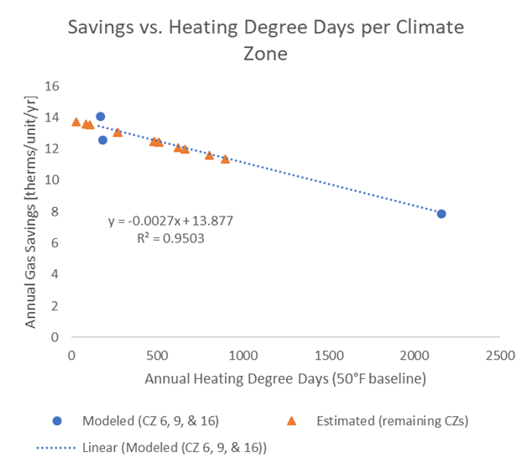
Measure Consensus
6.30 - Dual Set Point Boiler Control for Space Heating, Multifamily
  Savings
  Base Case
    Central hot water boiler with a basic aquastat controls serving an existing hydronic system in multi-family building.
    Combined space heating and domestic hot water
    Energy Plus model using the DOE Building Prototype as a basis
      eQUEST did not support combination boilers with supply water outdoor air temperature reset.
      Building geometry, materials, water heating systems, and HVAC systems were then manually modified to match the properties of the MASControl2 eQuest model
      Baseline: 135°F
  Measure Case
    Proposed: 135°F/120°F (at 55°F/75°F ambient hourly)
    Savings modeled for 3 climate zones (6, 9 and 16)
      Scaled to all climate zones using Heating Degree Days
Black text = Current state of the consolidated measure
Blue text = Changing and / or first time item is mentioned
Italics text = Item that has not been completed
Notes:
The measure case utilizes an electronic controller that responds to hot water demand and weather conditions by controlling the supply water temperature setpoint reset based on outside air temperature. With that, it fires the fewest stages needed to meet the heating load.
The application of combi systems (combined space heating and domestic hot water) during warmer weather allow the temperature of hot water delivered to the dwelling units to be turned down from 135°–140°F to about 120°F. This reduction in temperature setpoint allows the system to operate at lower heating capacity and reduces pipe heat loss in the distribution system, thereby saving energy. Furthermore, the advanced controller monitors return water temperature to further reduce supply water setpoint during periods of warmer weather and/or low building heating demand. Another feature is burner staging optimization to prevent temperature setpoint overshooting or short cycling.

Slide 20
Input Consensus
6.30 - Dual Set Point Boiler Control for Space Heating, Multifamily
Measure Permutations

Slide 21
Measure Consensus
5.06 - Demand Controlled Ventilation for Single Zone Packaged HVAC, Commercial
  Offering
  Implementation: AOE
  Building Types:
    Asm,EPr,ERC,ESe,EUn,MBT,
    OfS, RFF,RSD,Rt3,RtL,RtS
  Climate zones: CZ01-CZ16
  Norm Unit: Cap-Tons
  Offerings include:
    ADEC / No ADEC or CO2 Sensor; DX only / DX Furnace / Heat Pump
  Stage 1 Issues
  Measure updated to include portable classrooms and CZ07 permutations
  Must update savings using the latest building prototypes and new Peak Period
  Savings from 2018 (next slide)
  Measure Extension
  Add POUs, PG&E and SDG&E
Stage 2 Issues
  None.
Black text = Current state of the consolidated measure
Blue text = Changing and / or first time item is mentioned
Italics text = Item that has not been completed
Notes:
Add Demand Controlled Ventilation (DCV) to an existing packaged single zone direct expansion (DX) HVAC unit with an economizer. The specific DCV application uses a carbon dioxide (CO2) sensor to inform economizer outside air damper position. HV026, HV028, and HV030 are for adding an Advanced Digital Economizer Controller (ADEC) with DCV capability as well as a CO2 sensor. HV027, HV029, and HV031 are for adding a CO2 sensor only assuming a DCV-enabling digital controller is already installed. The three measure codes for each case distinguish between cooling units with gas heat, cooling only units, and heat pumps, respectively. The ADEC must have the capability to control the damper in response to a CO2 sensor signal.
Constant volume single zone packaged HVAC systems provide a fixed amount of outside air ventilation to a space, with the exception of systems with airside economizers which are intended to provide up to 100% outside air for cooling when outside air conditions permit. When not economizing, most systems that do have economizers provide a fixed minimum amount of outside air. For systems that do not have the ability to adjust ventilation in response to occupancy, Title 24 2016 requires the minimum outside air to be determined based on the greater of:
1. The floor area-dependent ventilation rate required by Title 24 Table 120.1-A (CFM/sq. ft.)
2. 15 CFM per person using peak design occupancy for the space per Title 24 §120.1(b)2
This requirement results in a safe and healthy level of ventilation being supplied to the space during times of peak occupancy but may result in over-ventilation during times when the space has fewer occupants. When the occupant-dependent rate is greater than the floor-area dependent rate, DCV may be used to reduce the minimum amount of ventilation that must be supplied to the space. DCV allows the system to provide additional ventilation up to the occupant-dependent rate only when necessary for periods of high occupancy.
The particular application of DCV covered by this work paper operates an existing economizer outside air damper based on measured CO2 concentration in the space or return duct, which serves as a proxy for the occupant density in the space. Other applications may use occupancy sensors, other types of gas concentration sensors, or other means to vary outside air damper position and/or total supply air and outside air flow rates. These other applications are outside the scope of this work paper.
Implementation of DCV in this application requires installation of a CO2 sensor in the zone or return duct at a minimum. If an economizer controller with the ability to control damper position based on a CO2 sensor signal is already installed there are no additional hardware requirements beyond field wiring. HV029, HV030, and HV031 provide rebates for this situation. For units that do not have a suitable economizer controller with DCV capability, an ADEC with DCV capability may be retrofit to the existing economizer. HV026, HV027, and HV028 provide rebates for the installation of ADEC with a CO2 sensor.

Slide 22
Measure Consensus
5.06 - Demand Controlled Ventilation for Single Zone Packaged HVAC
  Stage 1 Issues
  Savings from Q1-Q3 2018
    Mix of building types
Black text = Current state of the consolidated measure
Blue text = Changing and / or first time item is mentioned
Italics text = Item that has not been completed
Notes:
Add Demand Controlled Ventilation (DCV) to an existing packaged single zone direct expansion (DX) HVAC unit with an economizer. The specific DCV application uses a carbon dioxide (CO2) sensor to inform economizer outside air damper position. HV026, HV028, and HV030 are for adding an Advanced Digital Economizer Controller (ADEC) with DCV capability as well as a CO2 sensor. HV027, HV029, and HV031 are for adding a CO2 sensor only assuming a DCV-enabling digital controller is already installed. The three measure codes for each case distinguish between cooling units with gas heat, cooling only units, and heat pumps, respectively. The ADEC must have the capability to control the damper in response to a CO2 sensor signal.
Constant volume single zone packaged HVAC systems provide a fixed amount of outside air ventilation to a space, with the exception of systems with airside economizers which are intended to provide up to 100% outside air for cooling when outside air conditions permit. When not economizing, most systems that do have economizers provide a fixed minimum amount of outside air. For systems that do not have the ability to adjust ventilation in response to occupancy, Title 24 2016 requires the minimum outside air to be determined based on the greater of:
1. The floor area-dependent ventilation rate required by Title 24 Table 120.1-A (CFM/sq. ft.)
2. 15 CFM per person using peak design occupancy for the space per Title 24 §120.1(b)2
This requirement results in a safe and healthy level of ventilation being supplied to the space during times of peak occupancy but may result in over-ventilation during times when the space has fewer occupants. When the occupant-dependent rate is greater than the floor-area dependent rate, DCV may be used to reduce the minimum amount of ventilation that must be supplied to the space. DCV allows the system to provide additional ventilation up to the occupant-dependent rate only when necessary for periods of high occupancy.
The particular application of DCV covered by this work paper operates an existing economizer outside air damper based on measured CO2 concentration in the space or return duct, which serves as a proxy for the occupant density in the space. Other applications may use occupancy sensors, other types of gas concentration sensors, or other means to vary outside air damper position and/or total supply air and outside air flow rates. These other applications are outside the scope of this work paper.
Implementation of DCV in this application requires installation of a CO2 sensor in the zone or return duct at a minimum. If an economizer controller with the ability to control damper position based on a CO2 sensor signal is already installed there are no additional hardware requirements beyond field wiring. HV029, HV030, and HV031 provide rebates for this situation. For units that do not have a suitable economizer controller with DCV capability, an ADEC with DCV capability may be retrofit to the existing economizer. HV026, HV027, and HV028 provide rebates for the installation of ADEC with a CO2 sensor.

Slide 23
Measure Consensus
5.06 - Demand Controlled Ventilation for Single Zone Packaged HVAC
Measure Permutations

Slide 24
Measure Consensus
5.49 - Enhanced Ventilation for Packaged HVAC with Gas Heating or Packaged Heat Pump, Commercial
  Offering
  Implementation: AOE
  Building Types: Asm,ECC,EPr,ESe,EUn,Htl,Hsp,MBT,Nrs,OfL,OfS, RFF,RSD,Rt3,RtL,RtS,SCn
  Climate zones: CZ01-CZ16
  Norm Unit: Cap-Tons
  Offerings include: 24 offerings
    ADEC / No ADEC or CO2 Sensor; DX only / DX Furnace / Heat Pump
  Stage 1 Issues
  Measure updated to include portable classrooms and CZ07 permutations
  Must update savings using the latest building prototypes and new Peak Period
  Significant savings for Q1-Q3 2018
  Measure Extension
  Add POUs, PG&E and SDG&E
Stage 2 Issues
  None.
Black text = Current state of the consolidated measure
Blue text = Changing and / or first time item is mentioned
Italics text = Item that has not been completed
Notes:
The target market for Enhanced Ventilation and VFD for Packaged HVAC Units with Gas Heating and Packaged Heat Pumps is spaces in commercial buildings served by packaged single zone HVAC units, sometimes referred to as rooftop units (RTUs). This fan motor and control upgrade for existing units is a Retrofit Add-on (REA) application, meaning Unit Energy Savings (UES) values provided are for an existing system without a 2-speed fan as the baseline. There are no above-code savings reported as Title 24 2016 §140.4 requires that systems that include an air side economizer shall have a minimum of two speeds of fan control during economizer operation in most of the building types and activity area types considered. The UES values are not appropriate for Replace on Burnout (ROB) or New Construction (NC) applications.
California Energy Commission. 2016 Building Energy Efficiency Standards for Residential and Nonresidential Buildings (Title 24, Part 6). Sacramento, California. June 2016
Base Measure (standard motor)
Due to motor reliability concerns at lower speeds, the minimum fan speed modeled for this measure is 40% of the rated motor speed when applied to a standard induction motor. Reliability concerns for induction motors controlled by VFDs are related to high voltage spikes, which can result in winding failure, in addition to overheating due to reduced cooling at very low speeds. Voltage spikes can be mitigated by maintaining short cable lengths and applying capacitance and/or inductance filters when necessary. Minimum speed recommendations for non-inverter-duty rated standard efficiency induction motors range from 5% to 50% for variable torque applications. The 50% minimum recommendation was published by one VFD manufacturer and is suspected to be overly conservative based on the recommendations from motor manufacturers and other VFD manufacturers. All the recommendations by motor manufacturers range from 5% to 20% minimum speed for new standard duty, standard efficiency induction motors. Variable torque applications, such as centrifugal fans used for RTU supply fans, are less susceptible to motor failures due to overheating at low speeds because of the low torque requirement at low speeds, which reduces the cooling requirement. Because this measure is intended for applications on existing motors, the 40% minimum speed was chosen as a conservative minimum speed for existing motors.
Base Measure with NEMA Premium Supply Fan Motor
This measure includes the base measure in addition to replacement of the existing standard induction motor with a NEMA Premium efficiency motor, which has a higher overall operating efficiency. The minimum motor speed modeled was reduced to 30% for NEMA Premium motors. The 30% minimum was chosen as a conservative minimum speed for new NEMA Premium motors that may or may not be inverter-duty rated. A review of manufacturers’ recommendations indicated that inverter-duty rated motors may be operated at speeds as low as 0.1%. Motor manufacturer minimum speed recommendations for non-inverter-duty rated NEMA Premium motors range from 5% to 20% of the rated speed.
Base Measure with Permanent Magnet Supply Fan Motor
This measure includes the base measure in addition to replacement of the existing standard induction motor with a Permanent Magnet Motor (PMM), which has higher operating efficiency than both standard induction and NEMA Premium motors, especially at reduced speeds.
The minimum motor speed modeled was reduced to 20% for the PMM measure. The 20% minimum speed was based on engineering estimation of the lowest practical speed for an RTU fan application. According to the only known manufacturer of PMMs compatible with VFDs, there is no practical lower limit to how slowly their motors can be operated.

Slide 25
Measure Consensus
5.49 - Enhanced Ventilation for Packaged HVAC with Gas Heating or Packaged Heat Pump
  Offering
Black text = Current state of the consolidated measure
Blue text = Changing and / or first time item is mentioned
Italics text = Item that has not been completed

Slide 26
Measure Consensus
5.49 - Enhanced Ventilation for Packaged HVAC with Gas Heating or Packaged Heat Pump
Measure Permutations

Slide 27
Measure Consensus
5.56 Single Package Vertical Heat Pump
  Offering
  Implementation: NR, AR
  Building Types: ERC (relocatable classroom)
    K-12 and Community Colleges
  Climate zones: CZ01-CZ16
  Norm Unit: Cap-Tons
  Offerings include: 7 offerings
    EER / COP: 10, 11, 11.5 EER
    Economizer / DCV Option
    NR / AR
  Stage 1 Issues
  Must update savings using the latest building prototypes and new Peak Period
  Savings from Q3 2018 (PG&E <25,000 kWh)
  Measure Extension
  Add POUs, SCE and SDG&E
Stage 2 Issues
  None.
Black text = Current state of the consolidated measure
Blue text = Changing and / or first time item is mentioned
Italics text = Item that has not been completed
Notes:
The base case for this measure is a standard efficiency single package vertical heat pump without air-side economizer or DCV controls. Each measure case is a higher efficiency SPVHP; cooling energy savings result from an improved energy efficiency ratio (EER) and heating energy savings result from an improved coefficient of performance (COP) over the base case. For those measure cases having an economizer, energy savings are realized when ambient conditions are suitable for free or assisted cooling and ventilation, minimizing compressor operation. For those measure cases having DCV, energy savings are achieved by reducing the minimum amount of ventilation supplied to the space during periods below peak occupancy. This reduces the amount of outside air brought into the space that would otherwise have to be conditioned, minimizing compressor operation.

Slide 28
Measure Consensus
5.56 Single Package Vertical Heat Pump
Measure Permutations

Slide 29
Measure Consensus
5.30 - Refrigerant Charge, Commercial
  Offering
  Implementation: BRO-RCx
  Building Types: Asm,Com,ECC,EPr,ERC,ESe,EUn,Hsp,Htl,MBT,MLI,Nrs,OfL, OfS,RFF,RSD,Rt3,RtL,RtS,SCn
  Climate zones: CZ01-CZ16
  Norm Unit: Cap-Tons
  Offerings include:
    With TXV / With No TXV; Increase or Decrease of Refrigerant Charge
  Stage 1 Issues
  DEER 2020 Updates: Values come from DEER
  Measure Extension
  Add POUs
Stage 2 Issues
  None.
Black text = Current state of the consolidated measure
Blue text = Changing and / or first time item is mentioned
Italics text = Item that has not been completed
Notes:
This measure involves refrigerant charge correction to nonresidential direct expansion (DX) air-cooled HVAC units. When an HVAC unit’s refrigerant charge does not meet the manufacturer recommended levels it results in a decrease in the unit’s energy efficiency ratio (EER).
Some units may be undercharged, which can result in decreased power draw but potentially longer run times. Other units may be overcharged, which can result in increased power draw but potentially shorter run times. In either case, energy savings can be achieved by correcting refrigerant charge to optimum levels based on the manufacturers’ specifications. This measure is only appropriate for 4-50% undercharged or overcharged units Systems undercharged or overcharged by <4% are not eligible for claimed savings. For units with multiple circuits, UES values must be applied to the tonnage of the circuit being recharged, not the tonnage of all circuits.

Slide 30
Refrigerant Charge, Condenser Coil Cleaning, and Evaporator Coil Cleaning, Commercial
  Savings
Black text = Current state of the consolidated measure
Blue text = Changing and / or first time item is mentioned
Italics text = Item that has not been completed

Slide 31
Measure Consensus
5.30 - Refrigerant Charge, Commercial
Measure Permutations

Slide 32
Measure Consensus
5.31 - Evaporator Coil Cleaning, Commercial
  Offering
  Implementation: BRO-RCx
  Building Types: Asm,Com,ECC,EPr,ERC,ESe,EUn,Hsp,Htl,MBT,MLI,Nrs,OfL, OfS,RFF,RSD,Rt3,RtL,RtS,SCn
  Climate zones: CZ01-CZ16
  Norm Unit: Cap-Tons
  Offerings include:
    With TXV / With No TXV; Increase or Decrease of Refrigerant Charge
  Stage 1 Issues
  DEER 2020 Updates: Values come from DEER
    25% of Refrigerant Charge Adjustment savings from DEER are non-RCA
    25% of non-RCA are Evaporator Coil Cleaning
  Measure Extension
  Add POUs
Stage 2 Issues
  None.
Black text = Current state of the consolidated measure
Blue text = Changing and / or first time item is mentioned
Italics text = Item that has not been completed
Notes:
Dirty or fouled evaporators restrict air flow, reduce heat transfer efficiency and compressor efficiency, and can increase compressor run time. Coil cleaning eliminates air blockages between fins and can remove dust, grime, and other contaminants from the fin and tube heat transfer surfaces thus improving heat transfer efficiency, decreasing compressor run time, and increasing efficiency.

Slide 33
Measure Consensus
5.31 - Evaporator Coil Cleaning, Commercial
Measure Permutations

Slide 34
Measure Consensus
5.32 - Condenser Coil Cleaning, Commercial
  Offering
  Implementation: BRO-RCx
  Building Types: Asm,Com,ECC,EPr,ERC,ESe,EUn,Hsp,Htl,MBT,MLI,Nrs,OfL, OfS,RFF,RSD,Rt3,RtL,RtS,SCn
  Climate zones: CZ01-CZ16
  Norm Unit: Cap-Tons
  Offerings include:
    With TXV / With No TXV; Increase or Decrease of Refrigerant Charge
  Stage 1 Issues
  DEER 2020 Updates: Values come from DEER
    25% of Refrigerant Charge Adjustment savings from DEER are non-RCA
    50% of non-RCA are Condenser Coil Cleaning
  Measure Extension
  Add POUs
Stage 2 Issues
  None.
Black text = Current state of the consolidated measure
Blue text = Changing and / or first time item is mentioned
Italics text = Item that has not been completed
Notes:
Dirty or fouled condenser coils restrict air flow, reduce heat transfer efficiency and compressor efficiency, and can increase compressor run time. Coil cleaning eliminates air blockages between fins and can remove leaves, dust, grime, and other contaminants from the fin and tube heat transfer surfaces thus improving heat transfer efficiency, decreasing compressor run time, and increasing efficiency.

Slide 35
Measure Consensus
5.32 - Condenser Coil Cleaning, Commercial
Measure Permutations

Slide 36
Measure Consensus
5.10f - Brushless Fan Motor Replacement, Residential
  Offering
  Implementation: NR, AR
  Building Types: DMo,MFm,SFm
  Climate zones: CZ01-CZ16
  Norm Unit: Cap-Tons
  Offerings include:
    Split Capacitor Motor (0.65 W/cfm) to Brushless Fan Motor (0.365 W/cfm)
  Stage 1 Issues
  DEER 2020 Updates: Using the latest building prototypes and new Peak Period
  Savings from Q3 2018 (330,000 kWh)
  Measure Extension
  Add POUs, PG&E and SDG&E
Stage 2 Issues
  None.
Black text = Current state of the consolidated measure
Blue text = Changing and / or first time item is mentioned
Italics text = Item that has not been completed
Notes:
A BFM has several advantages over a PSC motor:
PSC motors are typically used at two speeds, a cooling speed (high speed) and a heating speed (low speed).
Since a BFM has a higher efficiency at its design rating point and is much more efficient at lower speeds than the PSC, it reduces fan watt draw and saves energy during both heating and cooling. It is also configured to produce the same airflow as the PSC motor it replaces, so these is no loss in performance.
In cooling mode, a BFM rejects less heat into the airstream (heat that the air conditioner must remove). However, a BFM applied to a gas furnace produces a small increase in gas consumption since the heat normally rejected by the motor into the airstream must be provided by natural gas.
In cooling mode, it recovers the moisture on the coil as sensible cooling at very low watt draw.
The mode of operation where a furnace fan runs continuously (independent of compressor operation) is becoming more widespread in residences for the purposes of ventilation and/or added filtration. Therefore, more savings can be realized by the BFM because of these longer operating hours.
Field tests conducted as part of the PIER Research for the 2008 Standards suggest a median cooling fan power draw of 632 watts for the California New Construction Field Test Furnace Fan Watt Draw – as shown in the figure below (Attachment 9). Other field data has shown median power draws around 510 watts per 1000 cfm (Attachment 10).
For this work paper, a BFM is compared to a PSC as if they were both installed on identical systems (duct and furnace) at the same CFM and external static pressure.
BFM compared to Electronically Commutated Motor (ECM)
Compared to an ECM motor the BFM with shut-off time delay has multiple advantages:
Unlike an ECM motor, the BFM motor does not require a separate speed controller.
Unlike an ECM motor, the BFM motor is available for retrofitting in existing furnaces.
An ECM motor is controlled to attempt to produce a given airflow regardless of the amount of power required; on the other hand, a BFM motor is controlled to produce the same airflow as the PSC it replaces, resulting in significantly higher energy and peak savings. LBNL modeling indicates that an ECM motor controlled to produce a given airflow will increase watt draw on units with restrictive duct systems [360].
A DOE report [361] projected a savings of 75% (three times the savings of an ECM) for a Brushless Motor that was tuned to the capacity of the air conditioner and furnace.
A BFM motor costs less than an ECM motor.
A BFM with shut-off time delay recovers moisture on the coil as sensible cooling. This recovery is extremely efficient because the BFM runs at low speed and very low watt draw during the recovery phase.

Slide 37
Measure Consensus
5.10f - Brushless Fan Motor Replacement, Residential
Measure Permutations

Slide 38
Measure Consensus
5.13 - Fan Delay Controller for Air Conditioner, Residential
  Offering
  Implementation: NR, AR
  Building Types: DMo,MFm,SFm
  Climate zones: CZ01-CZ16
  Norm Unit: Cap-Tons
  Offerings include:
    Split Capacitor Motor (0.65 W/cfm) to Brushless Fan Motor (0.365 W/cfm)
  Stage 1 Issues
  DEER 2020 Updates: Using the latest building prototypes and new Peak Period
  Savings from Q3 2018 (6.6M kWh)
  Measure Extension
  Add POUs
Stage 2 Issues
  None.
Black text = Current state of the consolidated measure
Blue text = Changing and / or first time item is mentioned
Italics text = Item that has not been completed
Notes:
A typical residential AC unit cycles off both the compressor and the evaporator fan, if the thermostat setpoint temperature is met. When the compressor and evaporator fan are cut off in response to the thermostat control, the evaporator coil is still partially flooded with the liquid refrigerant. This residual liquid refrigerant can be used to provide space cooling optimizing and improving system efficiency. This can occur by running the evaporator fan for a short time after the compressor cycles off, referred to as “fan delay time”. After the compressor stops running, the evaporator fan continues running to circulate the indoor air across the evaporator coil to provide additional sensible cooling. Additional sensible cooling provided during the fan delay period postpones the start of the next cooling cycle. The reduction in cooling period results in energy savings, mitigating the penalty as a result of the increased run time of the fan.
There are two types of commercially available add-on fan delay controllers. One type has built-in logic to delay the evaporator fan cycle-off time based on compressor and/or evaporator fan cycling. The control logic directly correlates fan delay periods with compressor run times.
The other type of fan delay controller is a manual evaporator fan delay (cycle-off) controller, which typically extends evaporator fan operation for 0 to 90 seconds after the compressor has turned off. This measure only allows the installation of a fan delay controller with a built-in logic. Fan delay controllers with a manually prescribed delay time are allowed only when installed and commissioned by an approved HVAC contractor.

Slide 39
Measure Consensus
5.13 - Fan Delay Controller for Air Conditioner, Residential
Measure Permutations

Slide 40
Measure Consensus
9.01 - Pool Cover, Commercial
  Offering
  Implementation: NR
  Building Types: CRe, ECC, EUn, Fhc, MFm
  Climate zones: CZ01-CZ16
  Norm Unit: Area-ft2
  Offerings include:
    Existing pools only with no cover (ever)
    Indoor / Outdoor
  Stage 1 Issues
  Savings methodology – uses a calculator based upon RESPEC (DOE) pool software
    Averages typical conditions for significant variables like wind speed, shading factor, hours of operation.
  GSIA default used since this is only applicable to sites with no cover (no regressive baseline)
  EUL reflects a new Pool Cover
  Measure Extension
  Add SDG&E
Stage 2 Issues
  None.
Black text = Current state of the consolidated measure
Blue text = Changing and / or first time item is mentioned
Italics text = Item that has not been completed

Slide 41
Measure Consensus
9.01 - Pool Cover, Commercial
Measure Permutations

Slide 42
Measure Affirmation
“Cal TF affirms the subcommittee recommendations regarding ‘Stage 1 Issues’ for various Measures.”
2.20, Conveyor Broiler, Commercial
2.21, Refrigerated Chef Bases
7.13, Under Counter Type Dishwasher, Commercial
7.36, Gas Dryer Modulating Valve, Commercial
6.29, Flow Control Valve, Res & Non-Res
6.30, Dual Set Point Boiler Control for MF Space Heating
5.06, Demand Controlled Ventilation for Single Zone Packaged HVAC
5.49, Enhanced Ventilation for Packaged HVAC with Gas Heating or Packaged Heat Pump
5.56, Single Package Vertical Heat Pump, K-12 and Community Colleges
5.30, Refrigerant Charge, Commercial
5.31, Evaporator Coil Cleaning, Commercial
5.32, Condenser Coil Cleaning, Commercial
5.10f, Brushless Fan Motor Replacement, Residential
5.13, Fan Delay Controller for Air Conditioner, Residential
9.01, Pool Cover, Commercial

Slide 43
Back-up Slides

Slide 44
Measure Consensus –
5.06 Demand Controlled Ventilation for Single Zone Packaged HVAC
Offering
  Workpaper (PGECOHVC168 R2, Dec 2011)
  Base Case:
    (PG&E & SCE) Fixed position ventilation corresponding to Title 24 2013 requirement or 20% of supply air, whichever is greater; (AC with Gas Heat, AC only, HP)
  Measure Case:
    Add Demand Controlled Ventilation (DCV) to an existing packaged single zone direct expansion (DX) HVAC unit with an economizer ; option of adding Advanced Digital Economizer Controller (ADEC)
Blue text = Changing and first time that item is mentioned
Italics text = Item that has not been completed

Slide 45
Measure Consensus -
5.06 Demand Controlled Ventilation for Single Zone Packaged HVAC
Savings
  Modeled measure with a DEER basis
  MASControl v3.00.19
  Prototype varied depending upon building
    Base models modified
    Measure models – unmodified prototype models
  Modeling assumptions:
    A minimum outside air fraction of 20% was used instead of 0 that indicates closed damper leakage for packaged HVAC systems are higher than previously thought.
    A maximum outside air fraction of 70% was used instead of 100% due to emerging research (was not yet published) that indicates return air damper leakage and exhaust air re-entrainment for packaged HVAC systems are higher than previously thought, leading to inability of most systems to provide 100% outside air.
    Hourly occupancy as a percentage of peak design occupancy was reduced to 90% in cases where the DEER occupancy schedule exceeded 90%. DCV savings are sensitive to occupancy, and work paper authors and other collaborators recognized that most buildings do not reach 100% occupancy on a typical day. Parties involved came to the consensus that an average daily maximum occupancy percentage of 90% would be appropriate in these cases. The existing default DEER peak occupant densities were retained.
    Economizer dry-bulb changeover temperatures were set in accordance with Title 24 2013 Table 140.4B
Measure | DEER Prototype Tech ID
Add ADEC and CO2 Sensor to AC unit with Gas Heat | D08-NE-HVAC-airAC-SpltPkg-110to134kBtuh-11p5eer
Add CO2 Sensor to AC unit with Gas Heat with ADEC | D08-NE-HVAC-airAC-SpltPkg-110to134kBtuh-11p5eer
Add ADEC and CO2 Sensor to AC only unit | *D08-NE-HVAC-airAC-SpltPkg-110to134kBtuh-11p5eer
Add CO2 Sensor to AC only unit with ADEC | *D08-NE-HVAC-airAC-SpltPkg-110to134kBtuh-11p5eer
Add ADEC and CO2 Sensor to HP | D08-NE-HVAC-airHP-SpltPkg-110to134kBtuh-11p5eer-3p4cop
Add CO2 Sensor to HP with ADEC | D08-NE-HVAC-airHP-SpltPkg-110to134kBtuh-11p5eer-3p4cop
Blue text = Changing and first time that item is mentioned
Italics text = Item that has not been completed

Slide 46
Measure Consensus –
5.56, Single Package Vertical Heat Pump
Offering
  Workpaper (PGECOHVC172 Rev 1, Sept 2018)
  Base Case:
    Existing standard efficiency single package vertical air-cooled heat pump (SPVHP).
  Measure Case:
    High efficiency (above code) single package vertical air-cooled heat pump with the option of included air-side economizer and demand control ventilation (DCV) controls.
  Offering
    Building Types: ERC (Education - Relocatable Classroom)
    PG&E CZ only, (CZ01-05, CZ11-13, CZ16)
    Norm Unit: cap-ton
    Measure Application Type: ER, ROB
Blue text = Changing and first time that item is mentioned
Italics text = Item that has not been completed

Slide 47
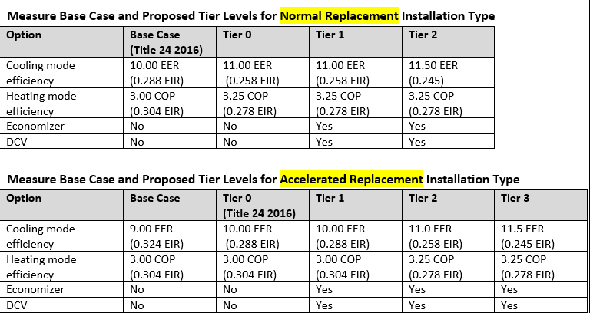
Measure Consensus –
5.56, Single Package Vertical Heat Pump
Savings
  eQUEST / MASControl v3.00.28
  Tech ID D08-NE-HVAC-airHP-Pkg-55to64kBtuh-15p0seer-8p2hspf with a 2007 vintage
  Keyword changes to simulate no ducts, no return fan, PTAC system, less than or equal to 90% occupancy, and tiered efficiency levels:
Blue text = Changing and first time that item is mentioned
Italics text = Item that has not been completed
Notes:
Hourly occupancy as a percentage of peak design occupancy was reduced to 90% in cases where the DEER occupancy schedule exceeded 90%. This change is consistent with workpaper SCE13HC061, which reasons that most buildings do not reach 100% occupancy on a typical day. Southern California Edison Company (2014, November 3). Work Paper SCE13HC061 Revision 0 – Demand Controlled Ventilation for Single Zone Packaged HVAC. Retrieved from http://deeresources.net/workpapers.

Slide 48
Measure Consensus -
5.30, Refrigerant Charge Adjustment
Savings
  Modeled measure with a DEER basis
  MASControl v3.00.20 and v3.00.27
  Prototype varied depending upon building
    Base models modified
    Measure models – unmodified prototype models
  Damper Leakage assumptions:
    A minimum outside air fraction of 20% was used instead of 0 that indicates closed damper leakage for packaged HVAC systems are higher than previously thought.
    A maximum outside air fraction of 70% was used instead of 100% due to emerging research (was not yet published) that indicates return air damper leakage and exhaust air re-entrainment for packaged HVAC systems are higher than previously thought, leading to inability of most systems to provide 100% outside air.
Modeled Faults | eQUEST Keyword | DEER Value | Modified Baseline Value | Fault Weight
RCA 0-20% | SYSTEM:COOLING-EIR | Varies | Existing COOLING-EIR * 1.152 Where 1.152 is the DEER RCA EIR adjustment factor | 0.95
RCA > 20% | SYSTEM:COOLING-EIR | Varies | Existing COOLING-EIR * 1.358 Where 1.358 is the DEER RCA EIR adjustment factor | 0.05
Blue text = Changing and first time that item is mentioned
Italics text = Item that has not been completed
Notes:
Should SCn be zero savings?

Slide 49
Measure Consensus –
5.31, Evaporator Coil Cleaning
Savings - Disposition
  Staff estimate that non-charge related services may account for an additional 25% savings on top of RCA.
    Gross Charge Adjustment Savings = DEER values
    Gross Non-Charge Adjustment Savings = DEER values * 0.25
  Commission staff recommends the following apportioning of non-charge adjustment savings among the three possible measures:
    Condenser Coil Cleaning: 50% of the total
    Evaporator Coil Cleaning: 25% of the total
    Air Flow Adjustment: 25% of the total
  Measure savings = DEER values * 0.25 * 0.25
    = DEER values * 0.0625
Blue text = Changing and first time that item is mentioned
Italics text = Item that has not been completed

Slide 50
Measure Consensus –
5.32, Condenser Coil Cleaning, Commercial
Savings - Disposition
  Staff estimate that non-charge related services may account for an additional 25% savings on top of RCA.
    Gross Charge Adjustment Savings = DEER values
    Gross Non-Charge Adjustment Savings = DEER values * 0.25
  Commission staff recommends the following apportioning of non-charge adjustment savings among the three possible measures:
    Condenser Coil Cleaning: 50% of the total
    Evaporator Coil Cleaning: 25% of the total
    Air Flow Adjustment: 25% of the total
  Measure savings = DEER values * 0.25 * 0.50
    = DEER values * 0.125
Blue text = Changing and first time that item is mentioned
Italics text = Item that has not been completed

Slide 51
Measure Consensus
5.42, Brushless Fan Motor for Residential Central AC
Offering
  Workpaper (SCE17HC028.1, Dec 2018)
  Base Case:
    Shaded pole (SP) or permanent split capacitor (PSC) motor; minimum 350 cfm/ton.
    Fan operates in (1) Auto or (2) Continuous mode.
  Measure Case:
    Brushless permanent magnet (BPM), direct current motor with selectable speed control designed to replace a PSC motor in a residential direct drive fan application.
Blue text = Changing and first time that item is mentioned
Italics text = Item that has not been completed

Slide 52
Measure Consensus
5.13, Efficient Fan Controller for Residential Air Conditioners
Offering
  Workpaper (SCE17HC052.0, Oct 2018)
  Base Case:
    The base case is a 14 SEER AC unit without an EFC.
  Measure Case:
    Efficient fan controller (EFC) device onto a residential single-family, multi-family or double-wide mobile home split-system air conditioner.
    EFC devices delay the evaporator fan cycle off time to take advantage of the residual liquid refrigerant remaining in the evaporator after the compressor cycles off.
Blue text = Changing and first time that item is mentioned
Italics text = Item that has not been completed

Slide 53
Measure Consensus
5.13, Efficient Fan Controller for Residential Air Conditioners
Savings
  Modeled measure (updated with latest Res prototypes – MC2)
    Minimally above-code SEER 14 split-AC system
    Cooling capacity varied by building type and climate zone based on the DEER building prototypes for double-wide mobile home, multi-family, and single family residential buildings
    DEER building prototypes updated in 2014 to include the Title 24 2008 and Title 24 2013 code based vintages
    Four hourly variables were captured from the eQUEST simulations:
      Total cooling load (Btu/hr),
      Condensing unit energy (kWh),
      Supply (indoor) fan energy (kWh), and
      AC total cooling capacity (Btu/hr)
    Hourly performance calculated using ET Study methodology with part-load modeled values
Blue text = Changing and first time that item is mentioned
Italics text = Item that has not been completed
Notes:
* Please note that eQuest runs were made using EER values equivalent to the SEER values used to describe the measures since straight SEER values cannot be input into the eQuest models [K].
** Note that the CFM is reduced in the measure case due to a down-sized unit.
*** Temperature Rise in the air stream across the supply fan. i.e., Temperature difference before and after the
supply fan (used to model static pressure)
**** Design full load power of the supply fan per unit of supply air flow rate for modeling static pressure
£ Fraction of the supply air that is lost from the ductwork.

