Slide 1
Clothes Washers
POU TRM / DEER Measure review
Subcommittee

Slide 2
Measure Review Objectives
Objectives:
Review TRM and DEER measures for accuracy, transparency, documentation
Compare values and methods
POU TRM
DEER
Other Jurisdictions
Issue recommendation on if, and how, to update the TRM measure

Slide 3
Summary of TRM and DEER Approaches
 | TRM | DEER
Sector (R/NR) | Res | Res
Base Case Description | Federal Standard MEF = 1.26 Does not meet Title 20 MEF = 1.60 (1/8/13) | Federal Standard, MEF 1.26 (historical)
Measure Case Description | MEF 2.0 – 2.4 | Varies
Savings Methodology | ENERGY STAR calculator | Inactive measure, historical baseline methodology unclear
Demand | N/A
EUL | 11 (DEER) | 11
Cost | $165 - $277 (PG&E WP, likely from DEER 2008 values) | Inactive – from 2006-2008

Slide 4
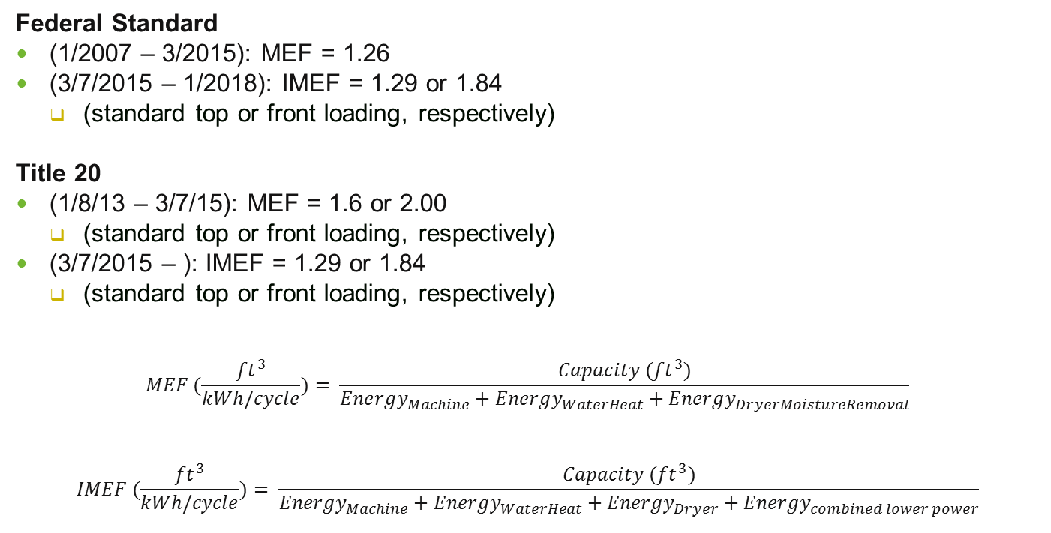
Baselines: Federal Code and T20
Federal Standard
(1/2007 – 3/2015): MEF = 1.26
(3/7/2015 – 1/2018): IMEF = 1.29 or 1.84
(standard top or front loading, respectively)
Title 20
(1/8/13 – 3/7/15): MEF = 1.6 or 2.00
(standard top or front loading, respectively)
(3/7/2015 – ): IMEF = 1.29 or 1.84
(standard top or front loading, respectively)
$$MEF (\frac{{ft}^{3}}{kWh/cycle})= \frac{Capacity ({ft}^{3})}{{Energy}_{Machine}+{Energy}_{WaterHeat}+{Energy}_{DryerMoistureRemoval}}$$
$$IMEF (\frac{{ft}^{3}}{kWh/cycle})= \frac{Capacity ({ft}^{3})}{{Energy}_{Machine}+{Energy}_{WaterHeat}+{Energy}_{Dryer}+{Energy}_{combined lower power}}$$

Slide 5
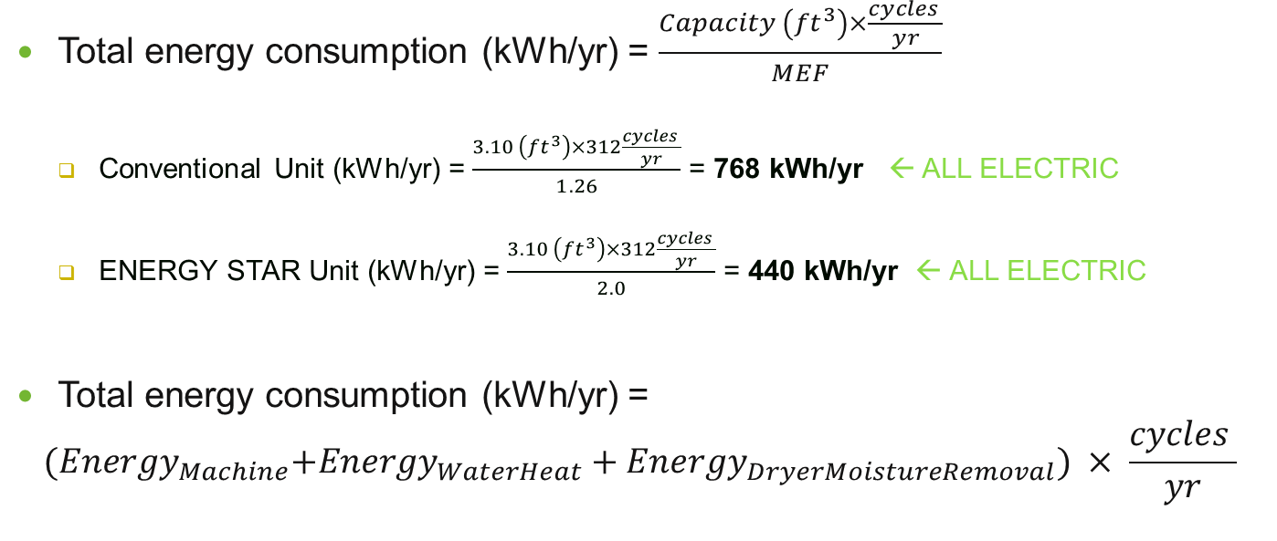
TRM: ENERGY STAR Methodology
Total energy consumption (kWh/yr) = $\frac{Capacity \left({ft}^{3}\right)×\frac{cycles }{yr}}{MEF}$
Conventional Unit (kWh/yr) = $\frac{3.10 \left({ft}^{3}\right)×312\frac{cycles }{yr}}{1.26}$ = 768 kWh/yr ← ALL ELECTRIC
ENERGY STAR Unit (kWh/yr) = $\frac{3.10 \left({ft}^{3}\right)×312\frac{cycles }{yr}}{2.0}$ = 440 kWh/yr ← ALL ELECTRIC
Total energy consumption (kWh/yr) =
$${(Energy}_{Machine}+{Energy}_{WaterHeat}+{Energy}_{DryerMoistureRemoval}) × \frac{cycles }{yr}$$
Baseline: 332 kWh/yr * 20%
ENERGY STAR: 148 kWh/yr * 20%
Baseline: 768 - 332 kWh/yr
ENERGY STAR: 440 - 148 kWh/yr
Baseline: 332 kWh/yr * 80%
ENERGY STAR: 148 kWh/yr * 80%

Slide 6
TRM ENERGY STAR Key Assumptions
Per cycle baseline consumption of 1.06 kWh/cycle
Federal Standard MEF = 1.26 (Title 20 standard is 1.60 for top-loading, 2.0 for front-loading as of 1/8/13); both standards changing to IMEF as of 3/7/15
Other source: “EPA research on available models, 2013”
Conventional unit (MEF=1.26) assumed to consume 417 kWh/yr, based on “research for available models” and “reference” of 392 cycles/yr per DOE Federal Test Procedures
Could not substantiate that Test Procedure annual kWh requirement for 392 cycles/yr for Appendix J2 for res (ES spec page 6)
417 kWh/yr / 392 cycles/yr = 1.06 kWh/cycle
Calculator assumes 295 cycles/yr as default
Per cycle measure consumption of 0.47 kWh/cycle
Source: “EPA research on available models, 2013”
ENERGY STAR unit (MEF = 2.0) assumed to consume 186 kWh/yr, based on “research for available models” and ES spec; 186 kWh/yr / 392 cycles/yr = 0.47 kWh/cycle
Per cycle energy consumption distribution (no source)
Machine energy – 20%
Water heating energy – 80%
Notes:
DOE Federal Test Procedure, Code of Federal Regulations, Title 10, Part 430, Subpart B, Appendix J:
“Other useful measures of energy consumption for automatic or semi-automatic clothes washers shall be those measures of energy consumption which the Secretary determines are likely to assist consumers in making purchasing decisions and which are derived from the application of appendix J1 or appendix J2, as appropriate. In addition, the annual water consumption of a clothes washer can be determined as…When using appendix J1, the product of the representative average-use of 392 cycles per year and the total weighted per-cycle water consumption in gallons per cycle determined according to section 4.2.2 of appendix J1…. When using appendix J2, the product of the representative average-use of 295 cycles per year and the total weighted per-cycle water consumption for all wash cycles, in gallons per cycle, determined according to section 4.2.11 of appendix J2”

Slide 7
TRM ENERGY STAR Key Assumptions
Unit capacity – 3.1 ft³
“EPA research on available models”
Gas water heater efficiency – 75%
DOE Federal Test Procedure, nominal gas water heater efficiency of 0.75
Cycles per year → annual consumption of 332 kWh/yr
POU TRM: 312 cycles/yr (arbitrary, 6 cycles/week is listed as ENERGY STAR default even though 295 is also listed as the “default”)
Calculator: 295 cycles/year default taken from 2012 DOE Technical Support Document for federal standard
DOE TSD cycles per year derived from 2005 RECS study
2009 RECS survey data available with CA-specific values
Weighted average cycles/year of approximately 261 cycles/yr for CA “homes that use a clothes washer”
Notes:
DOE Federal Test Procedure, Code of Federal Regulations, Title 10, Part 430, Subpart B, Appendix J:
“Other useful measures of energy consumption for automatic or semi-automatic clothes washers shall be those measures of energy consumption which the Secretary determines are likely to assist consumers in making purchasing decisions and which are derived from the application of appendix J1 or appendix J2, as appropriate. In addition, the annual water consumption of a clothes washer can be determined as…When using appendix J1, the product of the representative average-use of 392 cycles per year and the total weighted per-cycle water consumption in gallons per cycle determined according to section 4.2.2 of appendix J1…. When using appendix J2, the product of the representative average-use of 295 cycles per year and the total weighted per-cycle water consumption for all wash cycles, in gallons per cycle, determined according to section 4.2.11 of appendix J2”

Slide 8
TRM ENERGY STAR Calculator Results

Slide 9
DEER Documentation
Not a current measure in DEER
Lack of transparency on methods and assumptions
Historical energy savings
Historical cost data (from 2006-2008)
Water heating and dryer fuel type combination weighting from 2009 RASS included (not relevant for TRM, results not weighted)
2008 DEER cites CLASS as source for annual cycles; 2012 CLASS study does not include cycles/yr
EUL 11 years (Appliance magazine)
Other potential sources: 2012 CLASS CW age saturation, 2009 RECS CA data with CW age saturation

Slide 10
Other Jurisdictions
2012 DOE CW TSD indicates CW life of 14.2 years, per RECS data and Appliance magazine / manufacturer data
IL and RTF TRMs use CEC appliance database to determine average efficiency and capacity for given measure levels (may require shipment weighting if possible)
RECS data for cycles/yr (CA-specific data available for 2009)

Slide 11
Additional Comments
Accuracy
Title 20 baseline is out of date
Baseline comparison: RASS CW UECs (RASS results page 8) for motor energy only (121 kWh/yr for SFM, compared with baseline motor energy of 66 kWh/yr from ENERGY STAR calculator → unsupported assumption that 20% of cycle energy is attributable to machine energy)
Lack of transparency on
Assumptions for energy consumption for given efficiency levels
Assumptions for capacity for given efficiency levels
Distribution of energy usage (machine, water heat, dryer)
Cost assumptions (from old workpaper, DEER)
Reproducibility
Energy values could be reproduced with calculator, however some assumptions could not be reproduced (reference model energy consumption, capacity, % distribution of cycle energy)

Slide 12
Proposed TRM Revision Recommendations
Baseline efficiency should be updated to T20 standard
At a minimum the T20 baseline effective 1/2013, and as soon as possible the new T20 baseline effective 3/7/15
ENERGY STAR calculator currently being updated for new federal standard
Measure savings methodology should be more transparent and better supported
Consider requesting better supporting data from ENERGY STAR to support the calculator tool assumptions (capacity, energy consumption), or CEC appliance database information, AHAM shipment data
Use DOE TSD (Ch 7, p 7-7) for split between machine, dryer, water heating energy
Use DOE TSD (Ch8) for clothes washer EUL
Use 2009 RECS data for CA residential cycles/yr and include analysis
Longer term, consider using IOU statewide clothes washer workpaper as basis for IMEF

