Slide 1
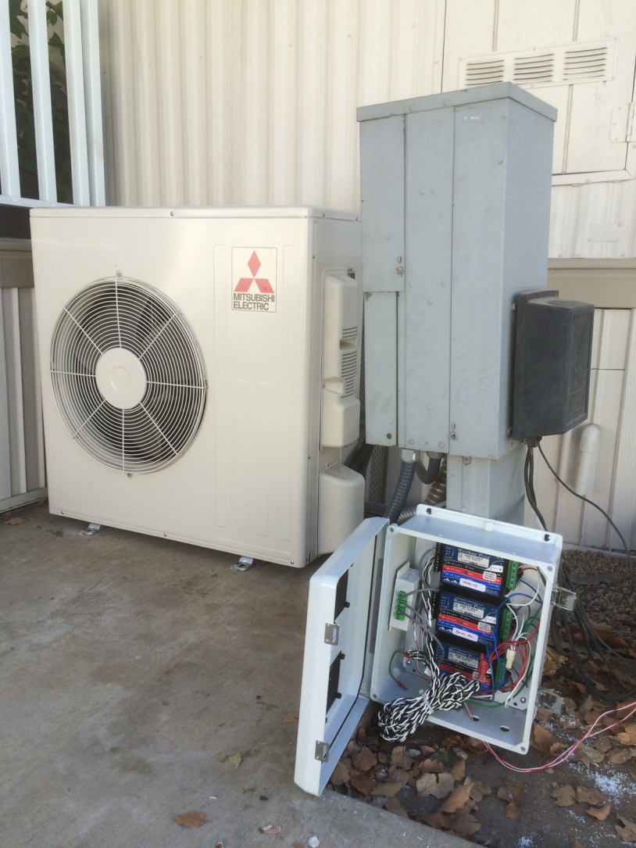
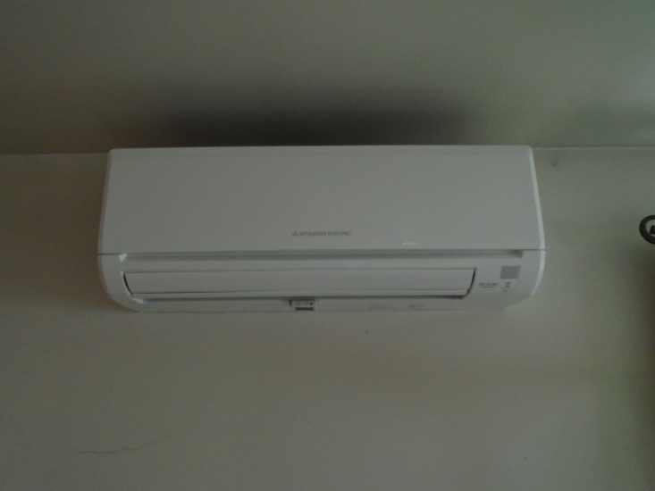
Sacramento Ductless Heat Pump Demonstration
Tom Eckhart/Greg Sullivan, UCONS
February, 2016

Slide 2
Presentation Overview
Objective:
Provide update to Sacramento DHP demonstration.
Also:
Seeking TF feedback on status and next steps
Utility direction on future technology demonstrations
Questions for TF

Slide 3
Summary of Sacramento Research Plan
Objective:
Evaluate the energy performance, temperature distribution, and occupant comfort of high efficiency, single-head, ductless heat pumps (DHP) installed in four Sacramento area manufactured homes.
Rationale:
Small study to initiate data collection, understand occupant behavior/satisfaction.
Data useful to confirm potential future activities, e.g., modeling, calibration, program development
Outcomes to assist in informing larger study

Slide 4
Summary of Sacramento Research Plan
Research Questions:
1. What fraction of the total cooling load will a single-head DHP be able to satisfy over the cooling season?
2. Of the fraction of cooling load displaced, what are the resulting energy savings in comparison to the existing central air conditioning system?
3. What are the differences in zonal temperature distributions (DHP versus existing AC) across the major living zones (living room, kitchen/dining, and bedrooms)?
4. In comparison to the central AC, how well does the DHP provide for occupant comfort? This research question will be answered through occupant surveys.

Slide 5
Summary of Sacramento Research Plan

Slide 6
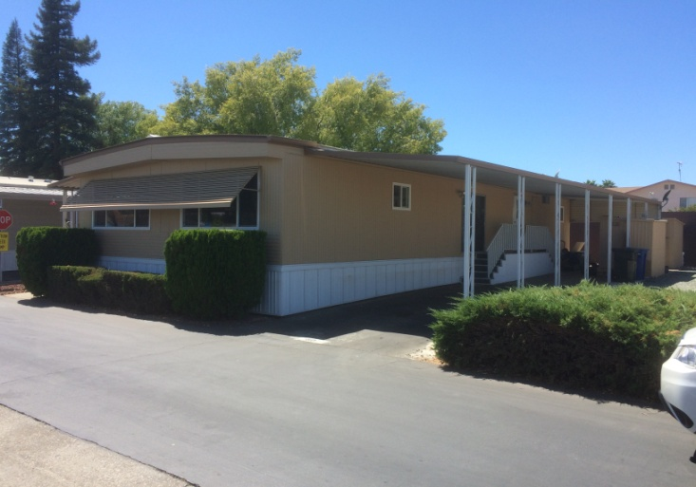
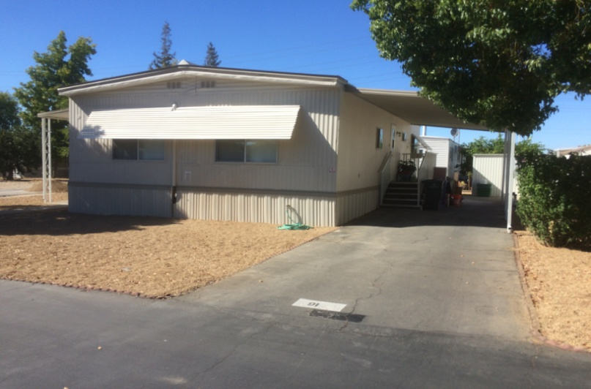
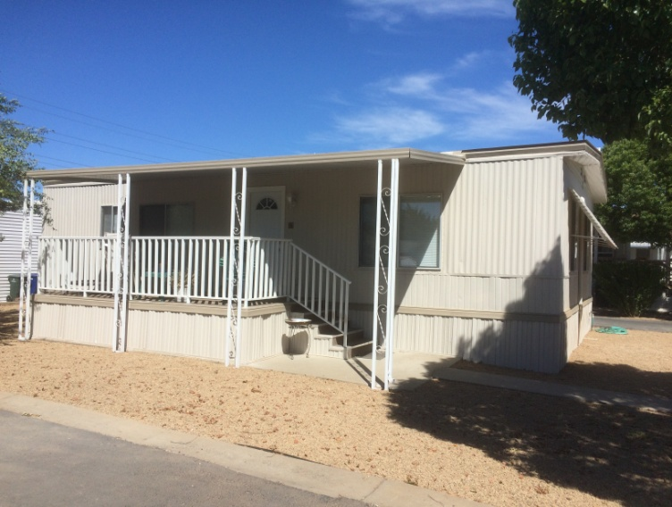
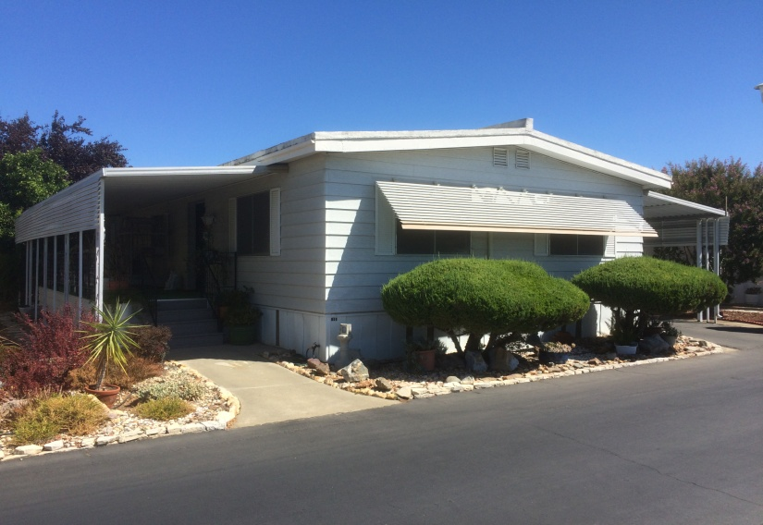
Summary of Sacramento Research Plan

Slide 7
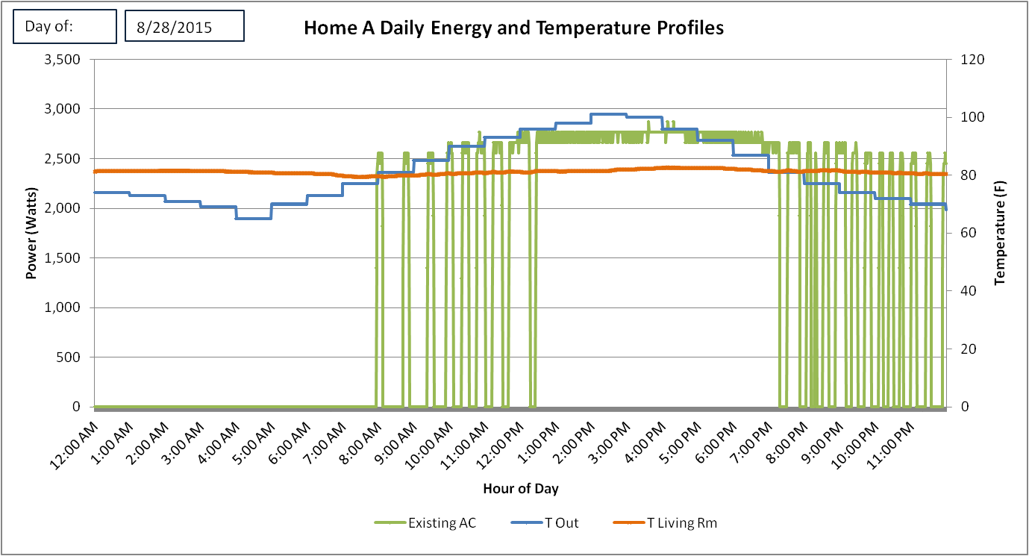
Preliminary Results
Existing System Daily Energy and Temperature Profile

Slide 8
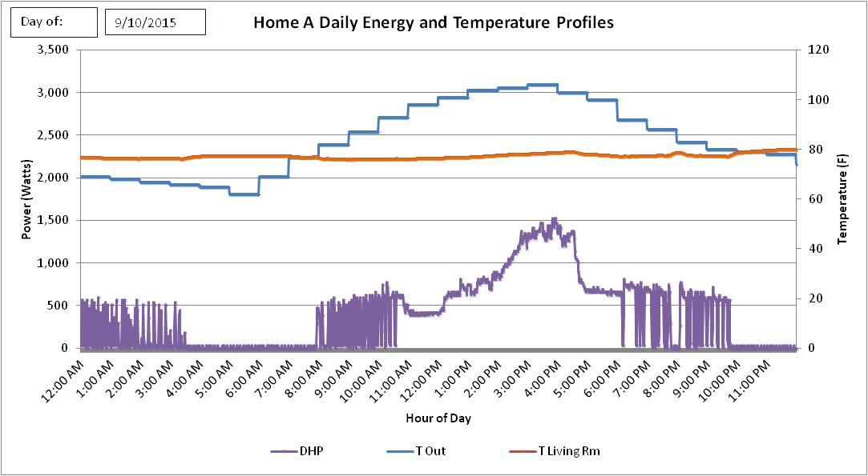
Preliminary Results
Ductless Heat Pump Daily Energy and Temperature Profile

Slide 9
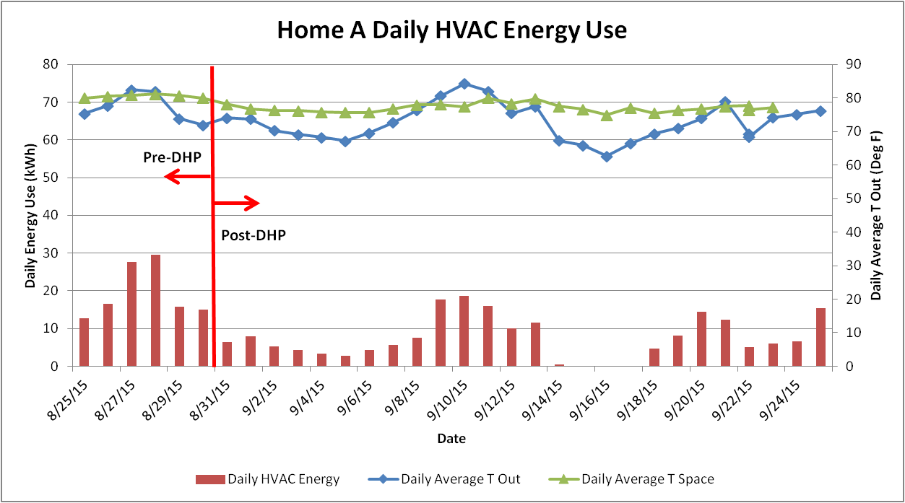
Preliminary Results
Daily Combined HVAC Energy and Temperature Profile

Slide 10
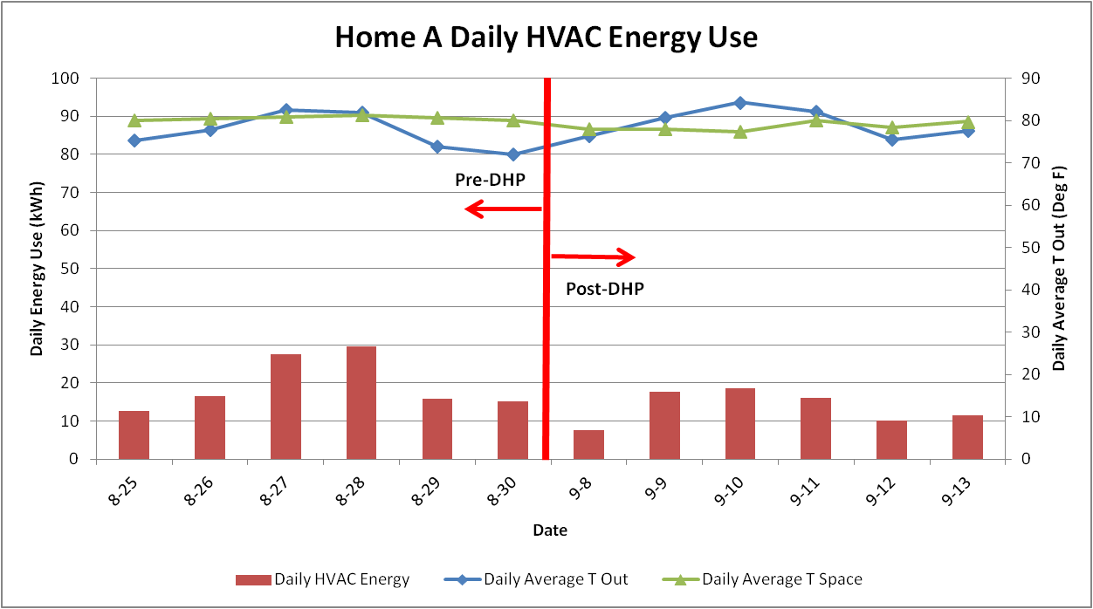
Preliminary Results
Daily Combined HVAC Energy and Temperature Profile

Slide 11
Preliminary Results
Home A
Pre/post savings analysis - comparable weather days:
Average Existing AC pre-kWh/day: 19.5
Average HVAC DHP kWh/day: 13.6
Average HVAC savings kWh/day: 5.9
Average HVAC savings %: 30.3 %
Runtime Tally
Percent Runtime Existing AC 18.5 %

Slide 12
Preliminary Results
Average HVAC Energy Savings Percentage – Post DHP Installation

Slide 13
Preliminary Results
Average Existing HVAC System Runtime Percentage – Post DHP Installation

Slide 14
Preliminary Results: Research Questions
Research Questions:
1. What fraction of the total cooling load will a single-head DHP be able to satisfy over the cooling season?
Homes studied to date report 70 % – 100%
2. Of the fraction of cooling load displaced, what are the resulting energy savings in comparison to the existing central air conditioning system?
Homes studied to date report 25% – 64%
3. What are the differences in zonal temperature distributions (DHP versus existing AC) across the major living zones (living room, kitchen/dining, and bedrooms)?
Living room comparable profile, back bedrooms warmer (2 F to 10 F)
4. In comparison to the central AC, how well does the DHP provide for occupant comfort? This research question will be answered through occupant surveys.
DHP well received, survey forthcoming

Slide 15
Next Steps/Questions
Seeking TF feedback on status and next steps
Utility direction on future technology demonstrations
Questions for TF
Path for follow-on larger study
Validate savings
Customer behavior/comfort/acceptance
Funding options and process for approval?
Thank you.

Slide 16
Additional Slides
Additional Home Data
Preliminary CVRH Cooling Season Findings
Relevant DHP Incentives in Pacific Power (N. California) Territory

Slide 17
Preliminary Results
Existing System Daily Energy and Temperature Profile

Slide 18
Preliminary Results
Existing System Daily Energy and Temperature Profile

Slide 19
CVRH Cooling Season Preliminary Findings
Findings not made public – for discussion purposes only

Slide 20
Pacific Power (N. California) DHP Incentive Program
Ductless Heat Pumps
Get up to $1,500 cash back
Go ductless and find your comfort zone
Make the move to a ductless heat pump and earn up to $1,500 cash back on your purchase.
Enjoy savings of up to 50 percent on your heating and cooling costs, and with no invasive ductwork, installation is easy and affordable.
http://www.homeenergysavings.net/homeowner/category/heating-and-cooling/in/california/ductless-heat-pumps?region=california

