Slide 1
Measure Property Data Meeting #5
Ayad Al-Shaikh
Randy Kwok
October 5, 2023

Slide 2
Agenda
Time to Start Reviewing!
Quick Review of Conventions (Randy)
Types of Alignment Issues (Ayad)
Focus on Approach in Collecting Data – Is it clear? (Randy)
Schedule Update & Next Steps (Ayad)
How to access information - refresher

Slide 3
Types of Alignment Issues
Is it in the Measure Package (MP)? | Valid and Feasible | Action
Yes | Yes | Keep Item
Yes | No | Keep Item, Remove from MP in future
No | Yes | Keep Item, Add to MP in future
No | No | Remove Item
Feasible – “possible to do”
Practical, achievable, not cost-prohibitive
Valid – “having a sound basis in logic or fact”
Usable, sufficient, valuable, relevant
Notes:
Valid - having a sound basis in logic or fact
Feasible - possible to do easily or conveniently

Slide 4
Proposed Schedule
Use Categories | Total Num | MPD Draft Due | Hand-off to External Stakeholders | Meeting with External Stakeholders | Final Comments from External Stakeholders
First Batch of HVAC | 12 | varies | 9/8 | 9/14 | (part of 3rd group)
Appliance/Plug Load, Bldg Envelope, Compressed Air, Comm Refrigeration | 37 | 9/8 | 9/22 10/19 | 10/5 | 11/3 11/16
Lighting, Service, Whole Bldg, Food Service, Misc | 40
Process, Recreation, HVAC | 47
Service and Domestic Hot Water, Water Pumping / Irrigation | 35

Slide 5
Next Steps
Get involved in external review – broken up by end-use:
Appliance/Plug Load, Bldg Envelope, Compressed Air, Comm Refrigeration
Next Meeting on Oct 5th
Lighting, Miscellaneous, Service, Whole Bldg, Food Service
Process, Recreation, HVAC
Service and Domestic Hot Water, Water Pumping/Irrigation

Slide 6
Next Steps
During review
Sheet 1: “Is item Valid and Feasible?”
If not, enter your name in cell (could just add to the list)
“Property Data Wrksheet”
Are Property Label / Property Description clear?
Changes
Highlight adjusted cells
Add Comment to “Stakeholder Comments” tab
Comments due for Big Batch #1 by 11/16/2023 – sooner is better.
Note that parallel process is to make updates for 1/1/2024 measure packages has started.

Slide 7
Questions?

Slide 8
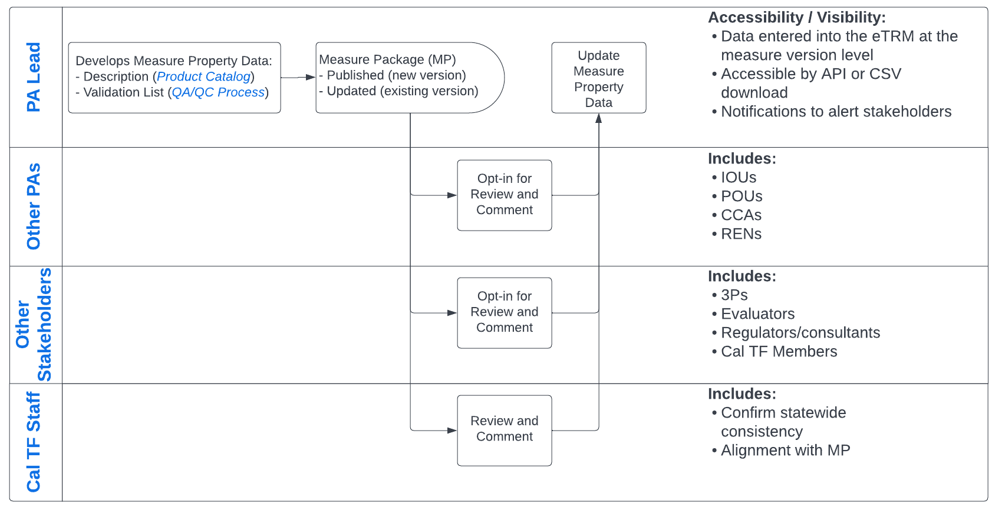
Statewide Process
Data Consensus
Notes:
Review by stakeholders who opt-in to the review.
Must align with approved MP; can elaborate on “how” to collect data, how to better vary by category fields
Note that these are recommendations for a starting point; PAs can modify / fine tune for specific programs

Slide 9
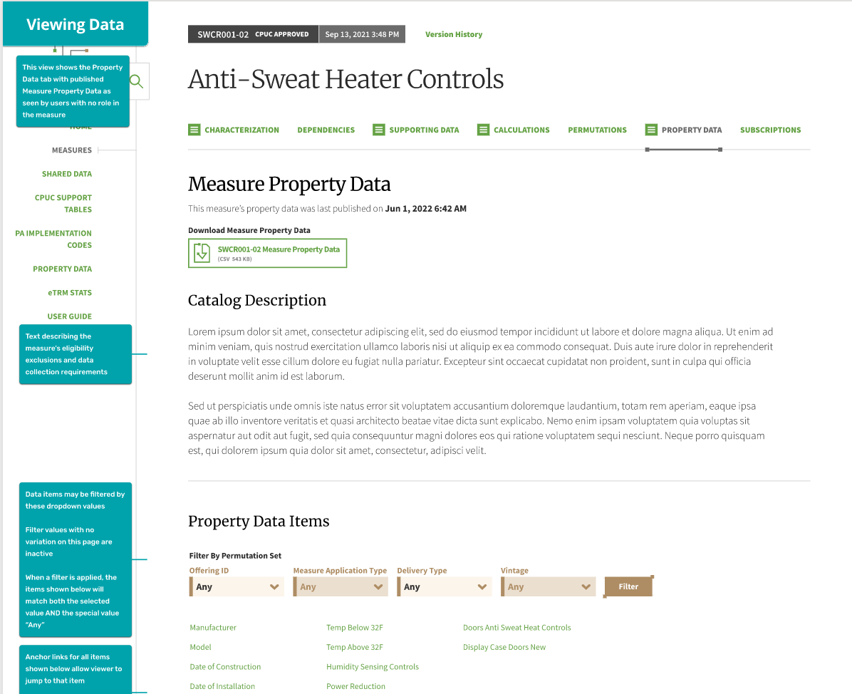
eTRM Wireframe
Separate tab for this data
Downloadable within the version
Hyperlinks to individual Validation Items
Filter for a specific permutation’s requirements
Download all validations lists

