Slide 1
Tier 2 Advanced Power Strip (APS)
Martin Vu
January 2016

Slide 2
Presentation Overview
Brief WP Procedural History
Foundational Understanding on Field Trial Methods
CalPlug Savings Verification System (SVS) Logging
Pre/Post Hobo Logging
Phase 2 Performance Results via Field Trial Methods
Energy Savings Performance Results
Survey Persistence Results
TF Input on How to Manage Differences in Results
Phase 3 Other Channels and Additional Developments

Slide 3
Procedural History

Slide 4
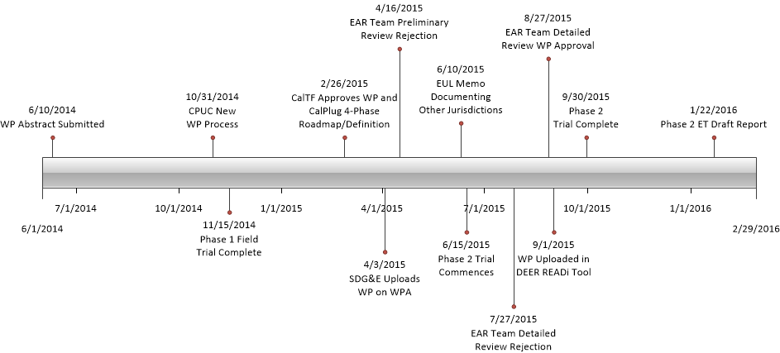
Procedural History

Slide 5
EAR Team Phase 1 WP Approval
UES Direct Impacts: 212 kWh and 0.0313 kW (wt. ave)
EUL: 5 yrs (33% Australian Persistence Study)
Future Actions
SDG&E, CPUC staff and ex ante consultants will be setting up regular deemed ex ante review calls. Additional requirements for future field trials will be established during these calls

Slide 6
Foundational Understanding on Field Trial Methods

Slide 7
Foundational Understanding on Field Trial Methods

Slide 8
Addressing the Weakness in the CalPlug SVS Logging Approach
Approach:
Simulates energy savings and eliminates user variability between pre and post time spans.
Weakness:
May not fully account for user interaction with APS system when system is turned off since the savings are simulated
Mitigation Strategy:
The instrumentation uses a flashing LED light to alert the host site users after a period of inactivity in order to illicit a remote control response.
All trial participants were specifically advised and shown how to respond to the LED light flashing during the field trial by pushing the button on their remote until the LED stopped flashing.

Slide 9
Addressing the Weakness in Pre/Post HOBO Monitoring
Approach:
Determines the energy saving performance by including all user interaction effects and feedback when things are turned off with APS controls in pre and post monitoring periods.
Weakness:
However, even slight variability in device usage patterns within the same household presents a large challenge in determining the actual energy saving performance of Tier 2 APS devices.
Therefore, pre/post method cannot control variability in usage patterns between pre and post time spans without prohibitive long term monitoring.
Mitigation Strategy:
This variability in usage patterns from one period to the next necessitates both larger sample sizes and longer trial periods to deliver a level of confidence in the energy saving performance of the device being tested when pre/post metering is used for field trial purposes.

Slide 10
Phase 2 Performance Results via Field Trial Methods Energy Savings

Slide 11
Phase 2 Field Trial
56 Host Sites
Participants: SDG&E customers representative subset of its territory
SVS
The simulation method was applied to 52 sites during phase 2 for both the IR and the IR-OS models and involved measuring baseline AV power and consumption while simultaneously measuring signals from remote controls and motion sensors to calculate energy savings
Pre/Post
The pre/post method compared demand and energy consumption between the baseline and post-installation periods for 56 sites to calculate energy savings for the IR-OS model only.

Slide 12
Phase 1 and 2 Field Trial Host Sites
 | Phase 1 | Phase 2
IR simulated savings | X | X
IR pre-post savings | X
IR-OS simulated savings |  | X
IR-OS pre-post |  | X
 | IR | IR-OS | Total
Number of usage baseline consumption | 98 | 56 | 98
Number of usable post consumption | 9 | 56 | 65
Number of usable simulated savings | 94 | 52 | 98
Average number of controlled AV devices | 3.6 | 3.4 | 3.6
Number of MFR sites | 28 | 16 | 28
Number of SFR sites | 70 | 40 | 70
Number of households with children | 37 | 24 | 37
Average number of residents | 3.1 | 3.1 | 3.1
Average self-reported weekly TV hours | 33 | 34 | 33
IR-OS studied in Phase 2 Only - Both SVS and Pre/Post Modes across 56 sites
IR studied in both phases in SVS mode only across 98 sites and 9 sites in phase 1 for pre/post mode
NOTE: Total may not be sum of each type due to overlap of control strategies studied at individual sites.

Slide 13
Phase 2 Energy Savings Performance Results
Phase | Baseline usage [kWh] | IR simulated savings [kWh] | IR pre-post savings [kWh] | IR-OS simulated savings [kWh] | IR-OS pre-post savings [kWh]
Phase 1 | 463 (n=42) | 234 (51%) (n=42) | 134 (29%) (n=9) | n/a | n/a
Phase 2 | 409 (n=56) | 199 (49%) (n=56) | n/a | 112 (27%) (n=52) | 104 (25%) (n=56)
Combined and normalized | 432 (n=98) | 214 (50%) (n=98) | 125 (29%) (n=9) | 118 (27%) (n=56) | 110 (25%) (n=56)
Baseline on-peak demand [W] N=56 | IR simulated on-peak demand reduction [W] N=56 | IR-OS simulated on-peak demand reduction [W] N=52 | IR-OS pre-post on-peak demand reduction [W] N=56
60 | 24 | 16 | 10

Slide 14
Phase 2 Survey Persistence Results

Slide 15
Survey Plan
Targeted 1,100 total installs across three zip codes in SDG&E territory.
(750 IR and 350 IR-OS)
Designed to explore customers’ experiences with the APS devices and factors that could affect persistence.
Participating customers were contacted via email and subsequent phone survey requests about 6-8 weeks after the APS was installed.
125 IR and 77 IR-OS customers responded and provided survey responses.
TechniArt installed the devices in two waves. They first installed IR model Tier 2 advanced power strips from October 2014 to January 2015. They then installed IR-OS model Tier 2 advanced power strips from April to June 2015.

Slide 16
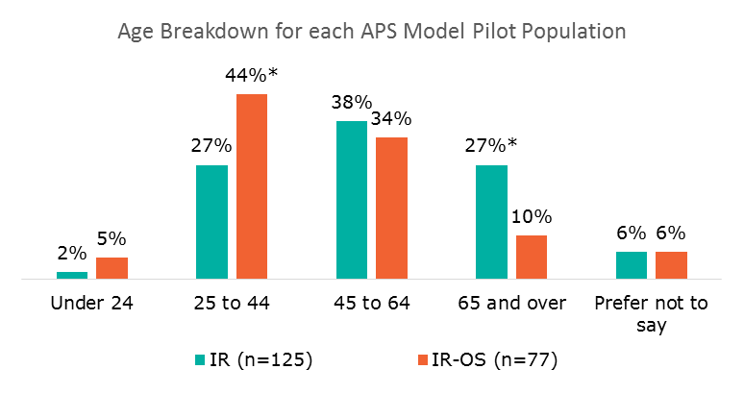
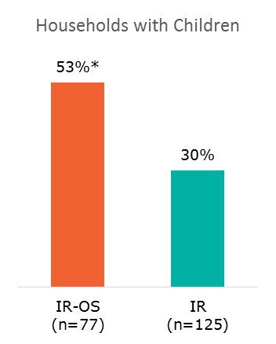
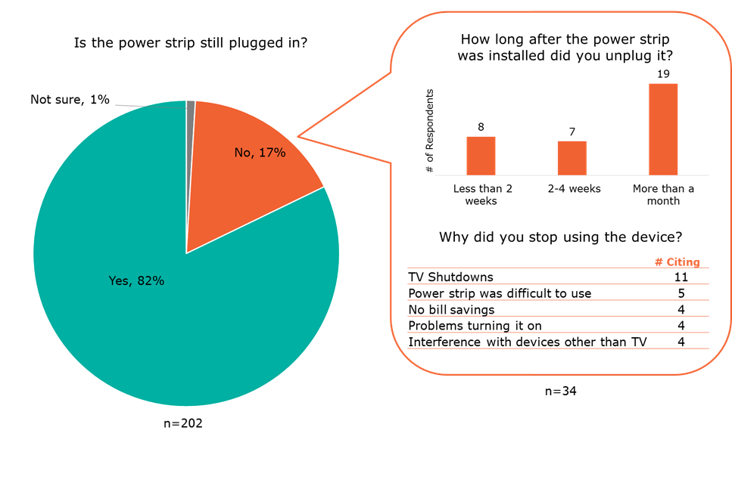
Phase 1 and Phase 2 Survey Results
Retirees and customers 65 and older were less satisfied with the APS and were less likely to recommend them to a friend or purchase additional units.
Households with children are significantly more likely to show interest in purchasing additional APS units and more accepting of the technology than households without children.
About 82% of direct install customers still had their power strips installed after 1 month.
Persistence rates for the IR and IR-OS models were 80% and 87%, respectively. The data was not normalized and other factors (i.e. IR deployment had significantly more retirees during deployment and duration of surveys was longer for IR than for IR-OS
There exists a difference in demographics and installation time which would impact the retention rate and other satisfaction rates of the IR model and the IR-OS models.

Slide 17
TF Input on How to Manage Differences in Results – Energy Savings

Slide 18
TF Input on How to Manage Differences in Results – Survey Persistence

Slide 19
Phase 3 and Additional Developments

Slide 20
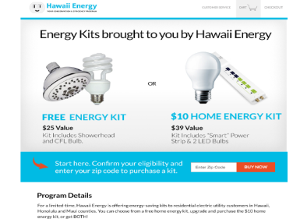
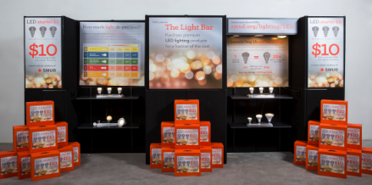
Additional Development – Phase 3
Example
Example
Upstream/Midstream Channel
Pop-up Assisted Retail
Utility-branded mobile retail locations hosted at high traffic locations (office buildings, hospitals, universities, public events, etc.)
Leverages an assisted sale methodology to deploy one-to-one customer education and encourage adoption.
Limited Time Offers (LTO)
Utility branded online portal offers product at reduced price.
Leverage the power of digital and social media to target customers.
Data Collection
Persistence and installation rate (but no field testing) for new channel
Pre/post field test for outstanding Phase 2 locations (IR units)
Persistence for Phase 2 sites (after longer period of time)
Measurement and Evaluation
Upstream/Midstream – EUL, NTG?
DI – Savings, EUL

Slide 21
Additional Development
Resource Development for PA
Specification
Develop performance-based specification (i.e. adopt from workpaper).
Certification Protocol
Establish a certification protocol and procedures for manufacturers to follow in order to qualify their models for the QPL.
Qualifying Product List (QPL)
Manage QPL to include models currently available in the market meeting specification.
CalPlug 4-Phase Roadmap Process?
Timeline
Q1 2016

